Slide 1
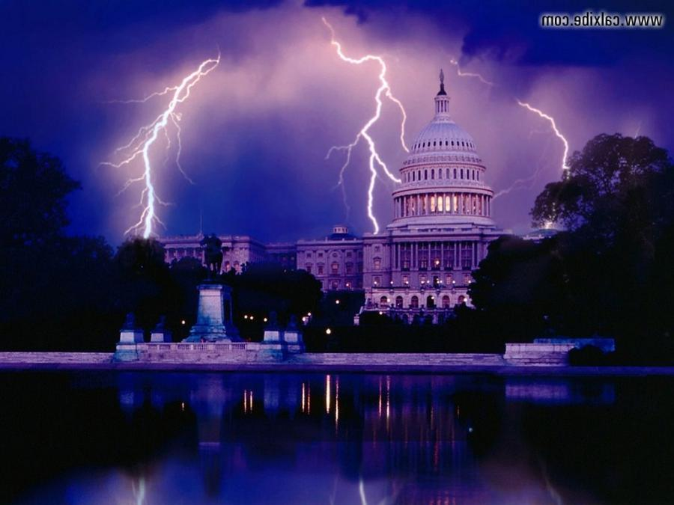
Current Events and Bible Prophecy

Slide 3
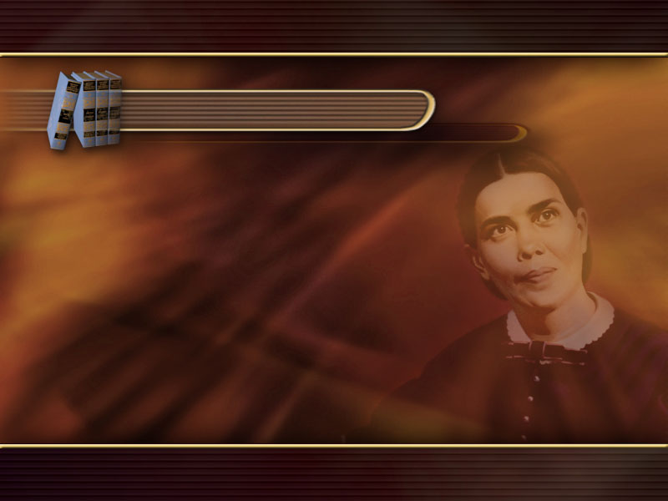
False Science paves the way for Papacy
GC 572
Thus the false science of the present day, which undermines faith in the Bible,
will prove as successful in preparing the
way for the acceptance of the papacy,
with its pleasing forms, as did the withholding of knowledge in opening the way for its aggrandizement in the Dark Ages.

Slide 4
1 Tim. 6:20.
O Timothy, keep that which is committed to thy trust,
avoiding profane and vain babblings, and oppositions of
science falsely so called.
False Science in Paul’s Time

Slide 5
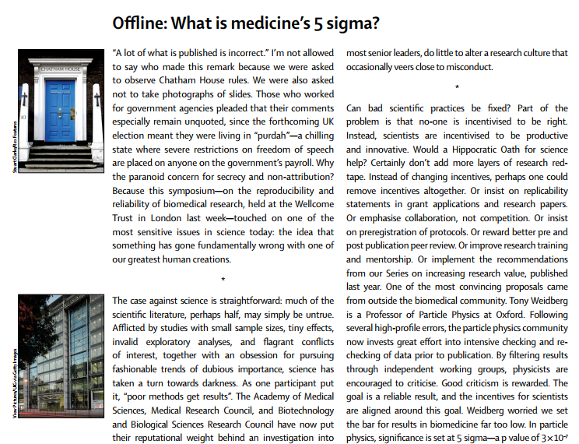
Richard Horton, editor-in-chief,
The Lancet, vol. 385, April 11, 2015.

Slide 6
Cannot Trust Medical Research
It is simply no longer possible to believe much of the clinical research that is published,
or to rely on the judgment of
trusted physicians or authoritative medical guidelines.
I take no pleasure in this conclusion, which I reached slowly and reluctantly over my two decades
as an editor of The New England Journal of Medicine.

Slide 8
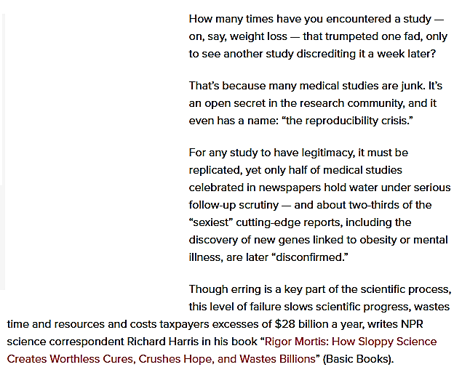

Slide 9
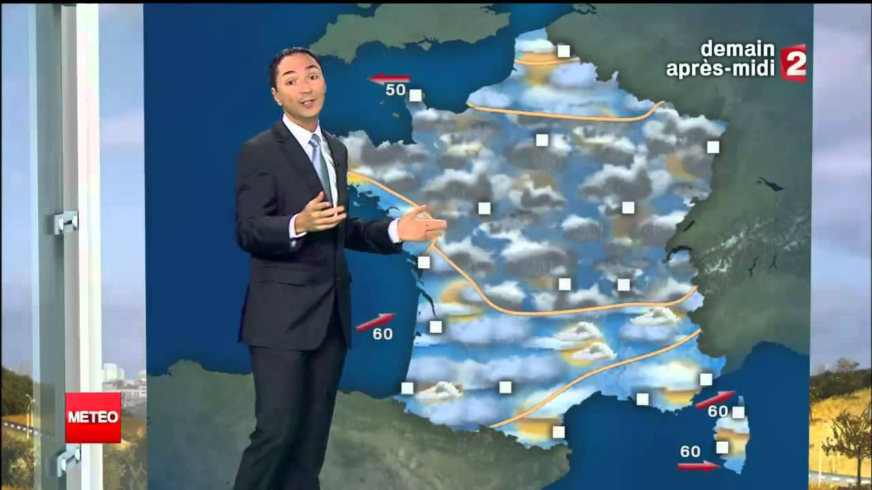
Philip Verdier

Slide 10
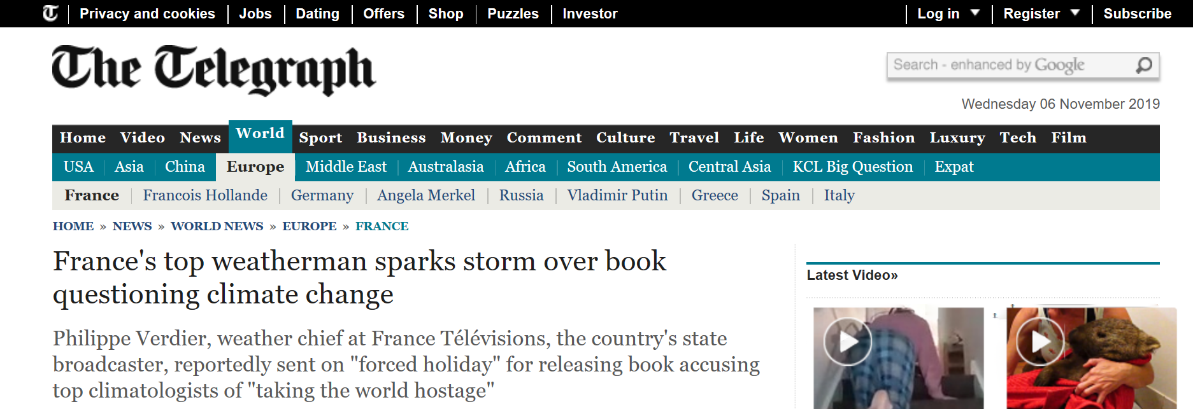

Slide 11
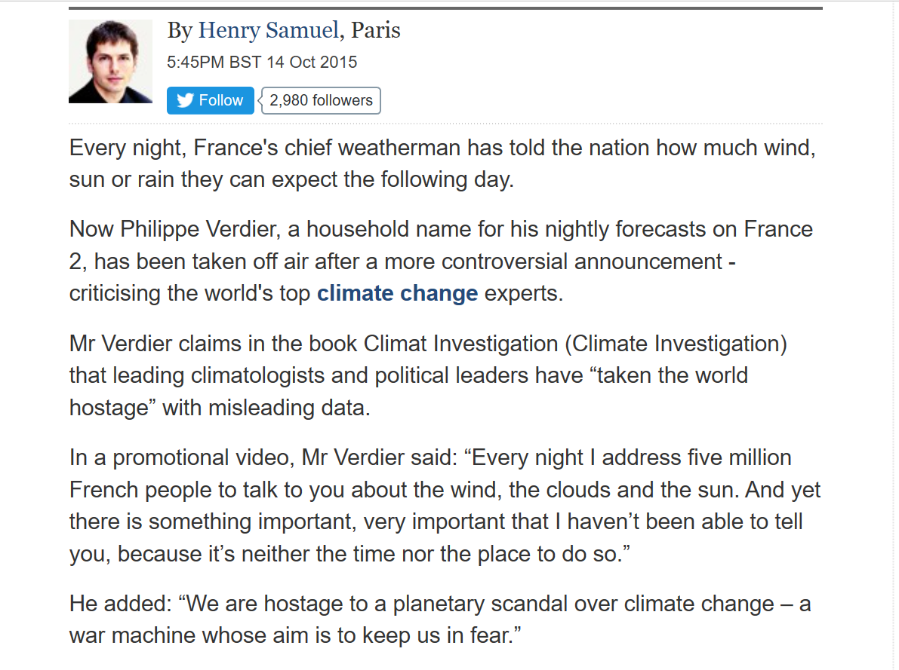

Slide 13
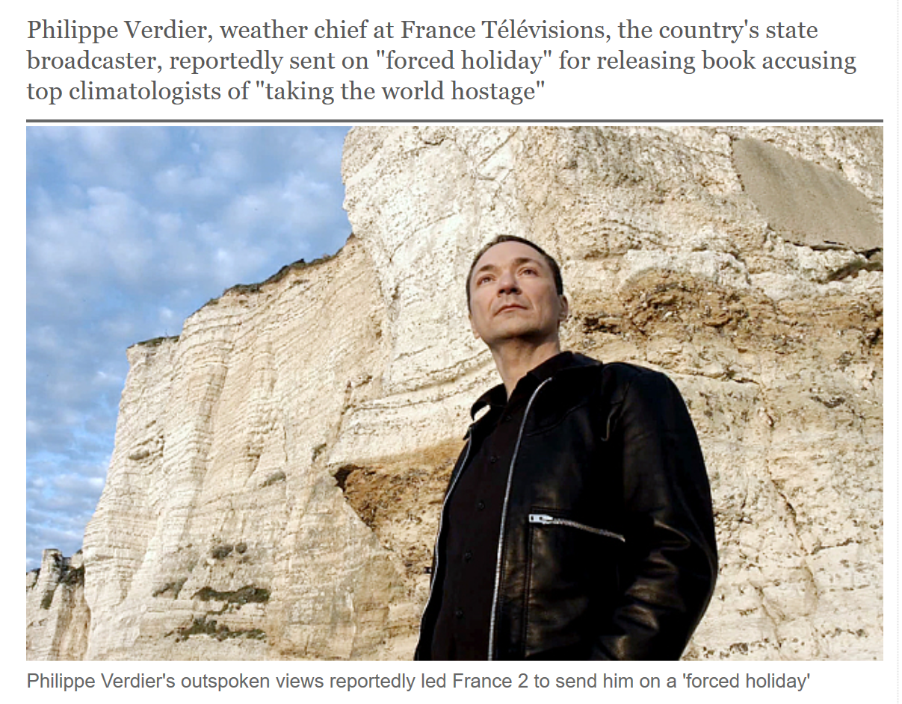

Slide 14
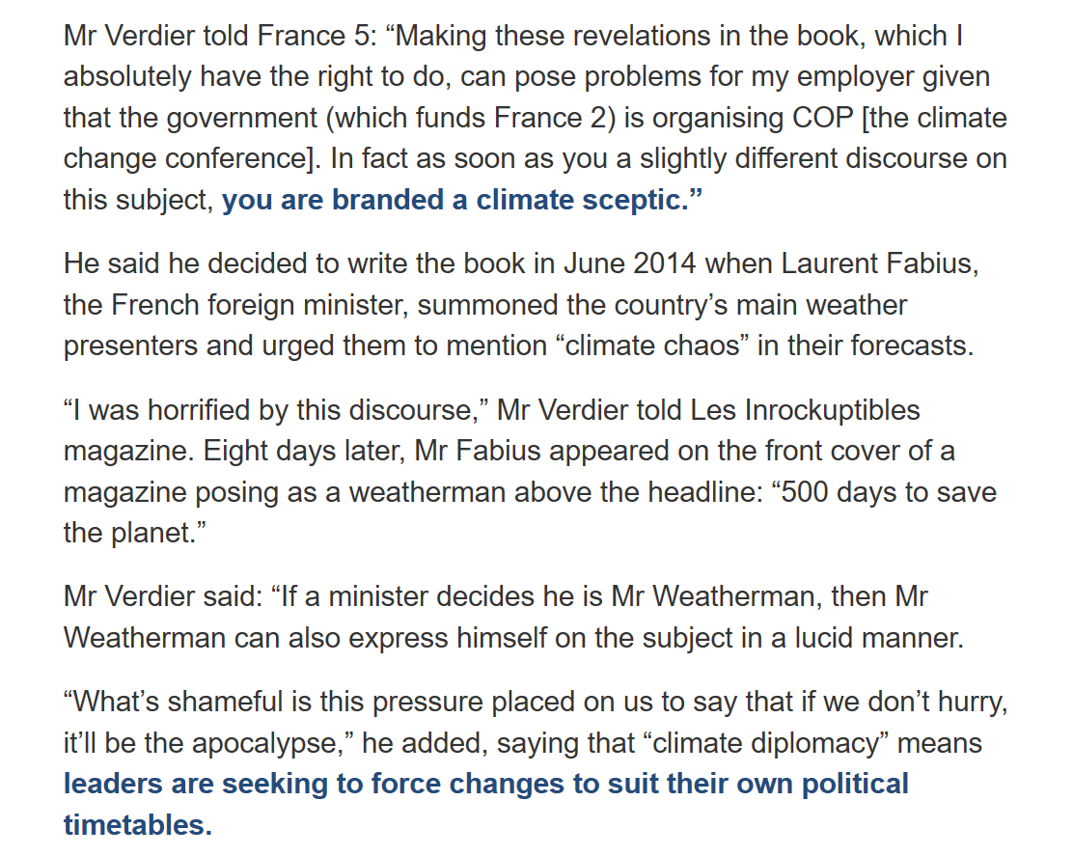

Slide 15
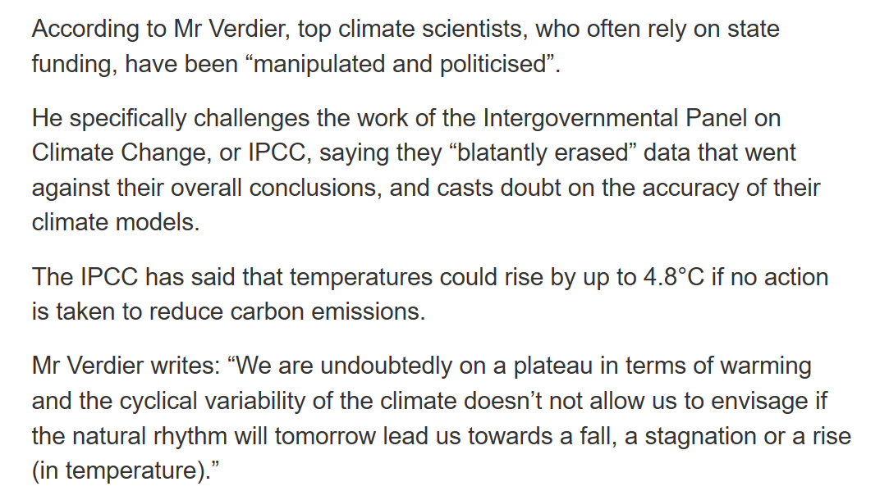

Slide 16
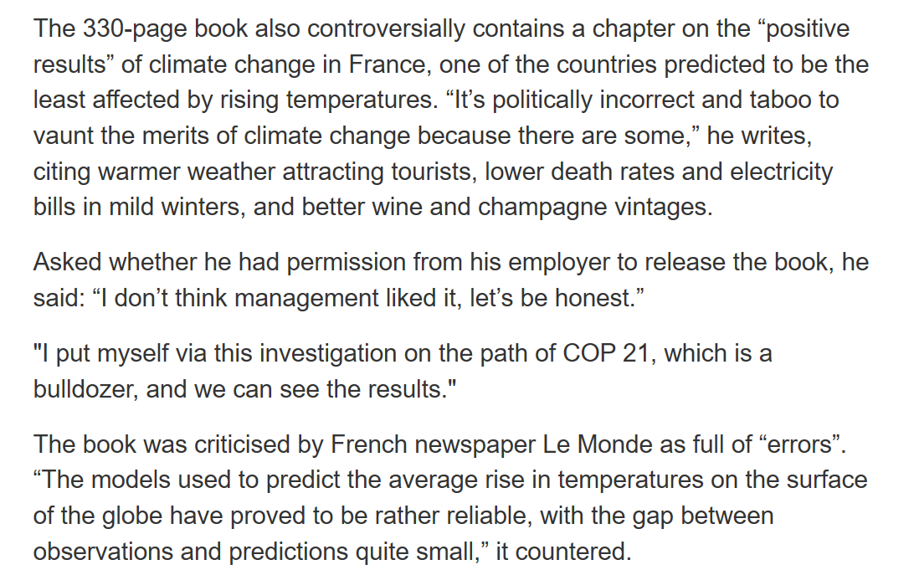

Slide 18
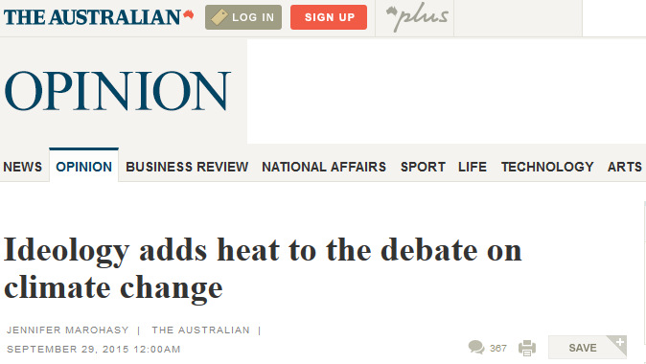
Australian Bureau of Meteorology caught falsifying data
For the true believer, it is too awful to even consider that the Australian Bureau of Meteorology could be exaggerating global warming by adjusting figures.
This doesn’t mean, though, that it’s not true.

Slide 19
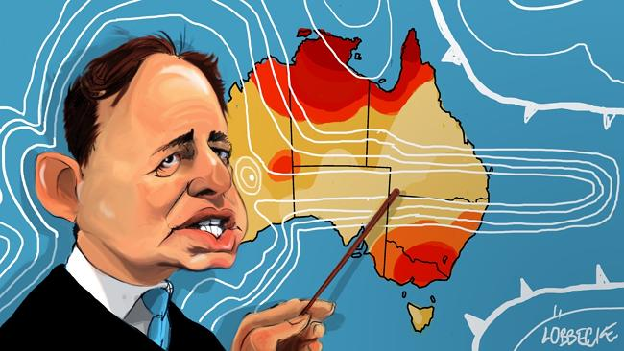
Ideology more important
than reality
It is so obvious that there is an urgent need for a proper, thorough
and independent review of operations at the bureau. But it would appear our politicians and many mainstream media are set against the idea. Evidently they are too conventional in their thinking to consider such an important Australian institution could now be ruled by ideology.

Slide 21
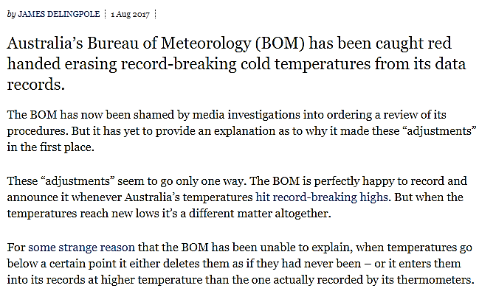

Slide 22
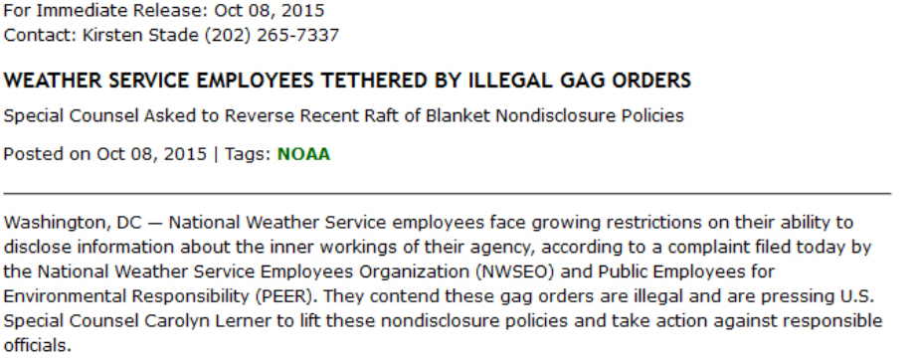

Slide 24
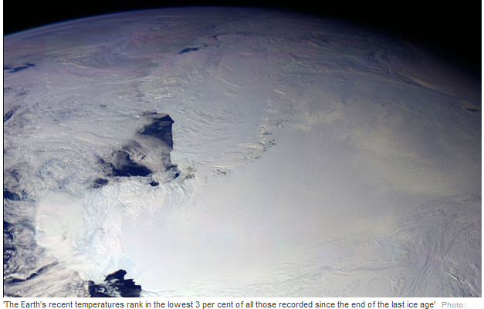

Slide 25
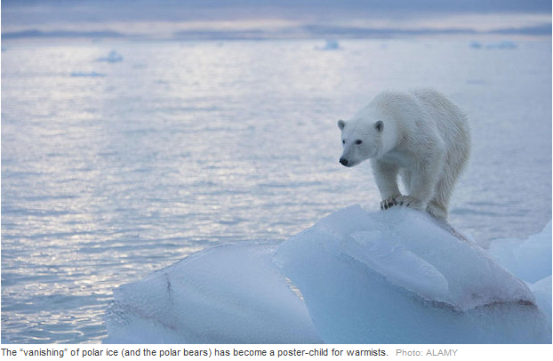

Slide 26
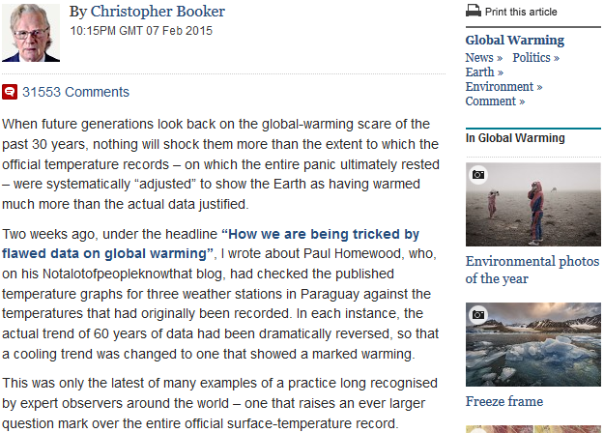

Slide 27
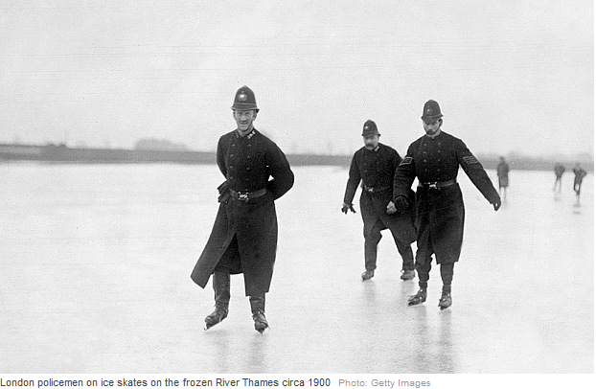

Slide 28
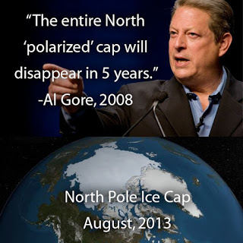

Slide 29
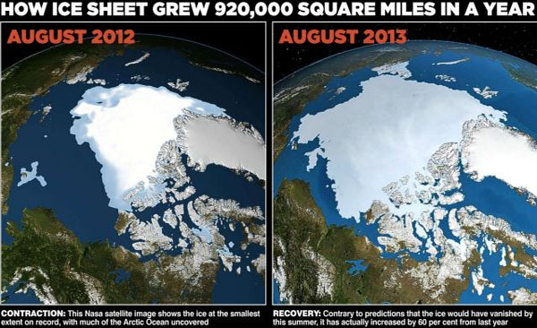

Slide 30
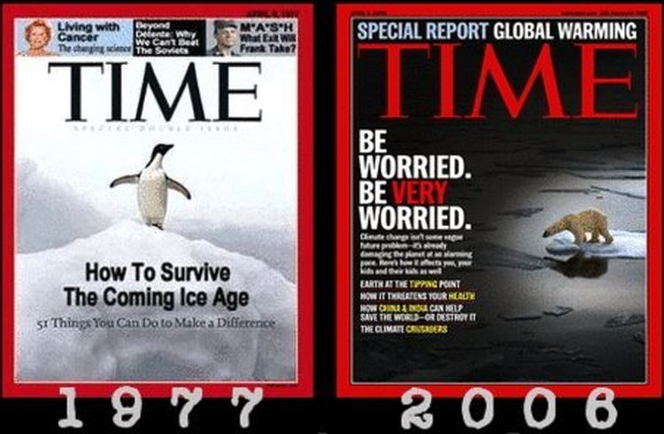

Slide 32
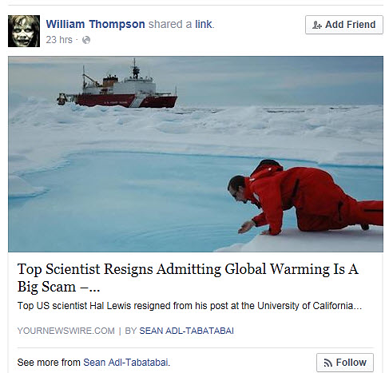
When I first joined the American Physical Society sixty-seven years ago it was much smaller, much gentler,
and as yet uncorrupted by the money flood…

Slide 33
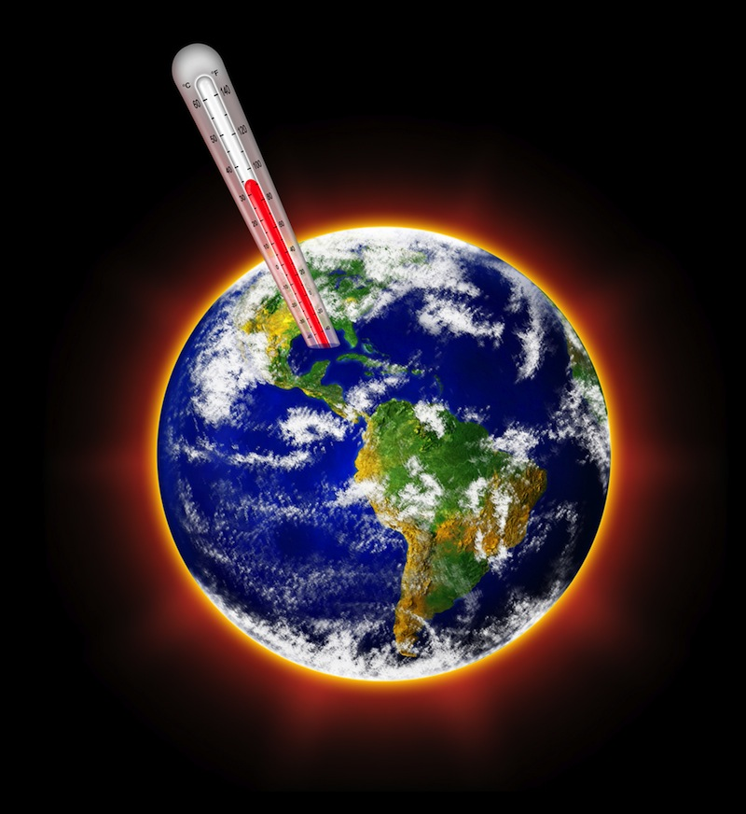
Trillions of Dollars Scam
It is of course, the global warming scam, with the trillions of dollars driving it,
that has corrupted so many scientists, and has carried
APS before it like
a rogue wave.

Slide 35
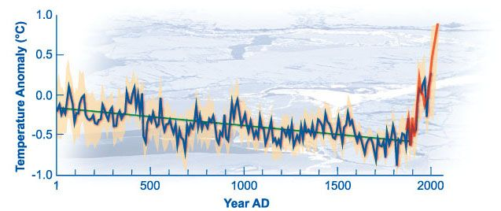
Michael Mann’s Hockey Stick

Slide 37
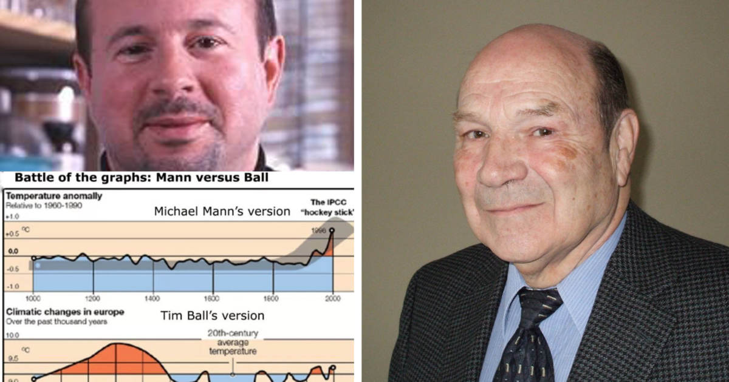

Slide 38
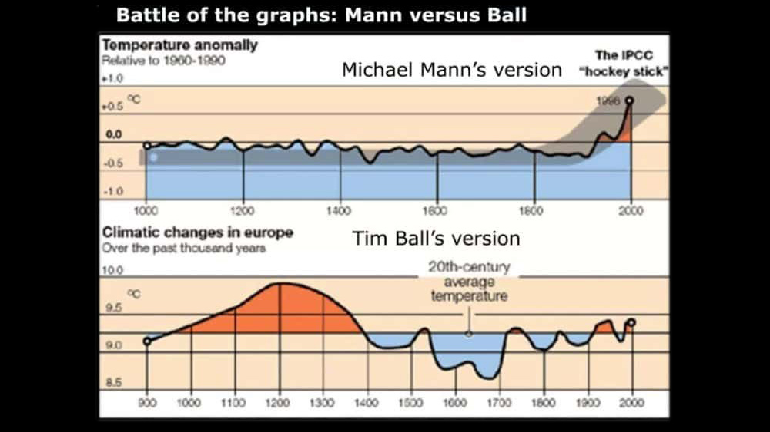

Slide 39
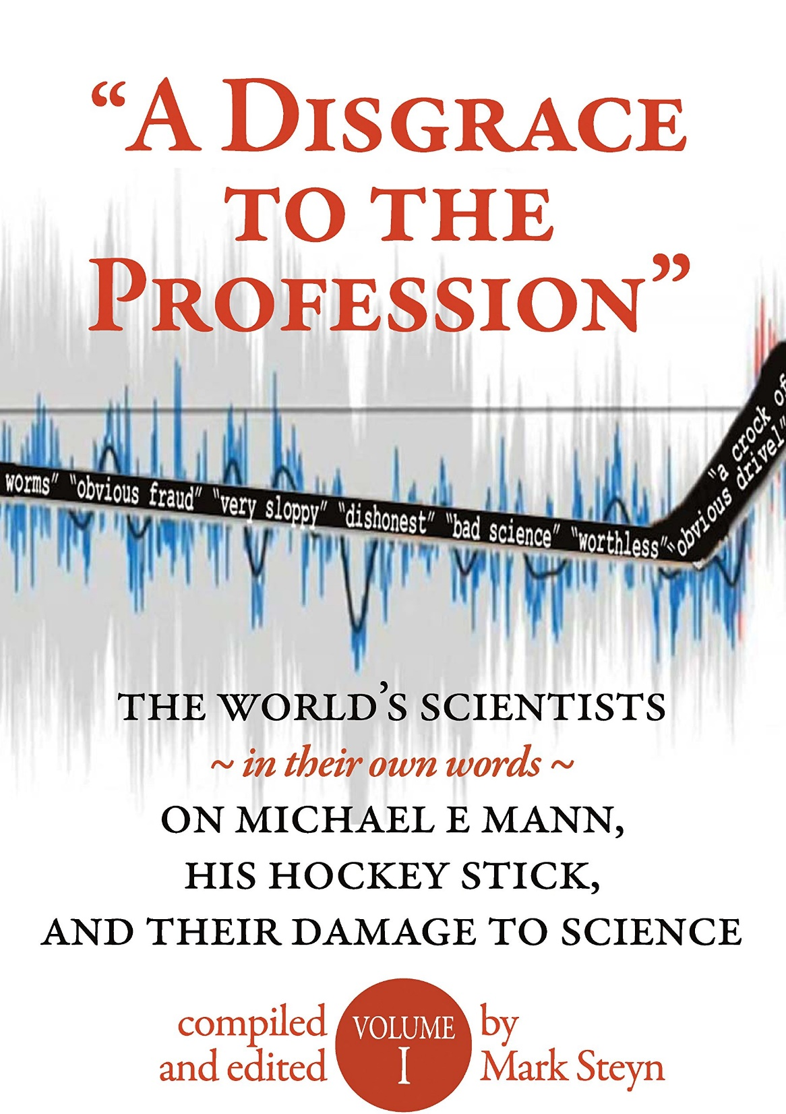
Repudiating the Hockey Stick
This was truly a case of selecting a desired conclusion and then molding the data to fit it. Andy May, Book Reviewer.

Slide 40
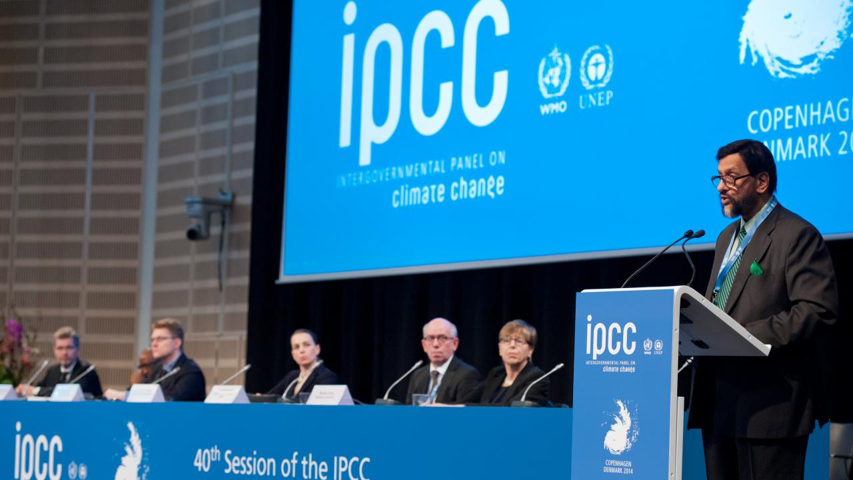

Slide 42
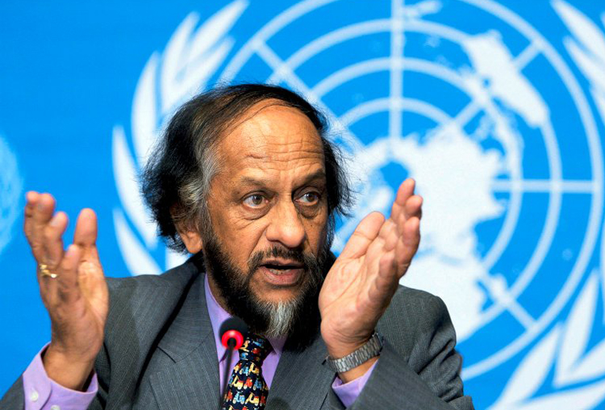
The Climate Change Cult
For me the protection of Planet Earth,
the survival of all species and sustainability of our
ecosystems is more than a mission.
It is my religion and my dharma.
Rajendra Pachauri, former head of the United Nation’s
Intergovernmental Panel of Climate Change (IPCC), Feb, 2015.

Slide 43
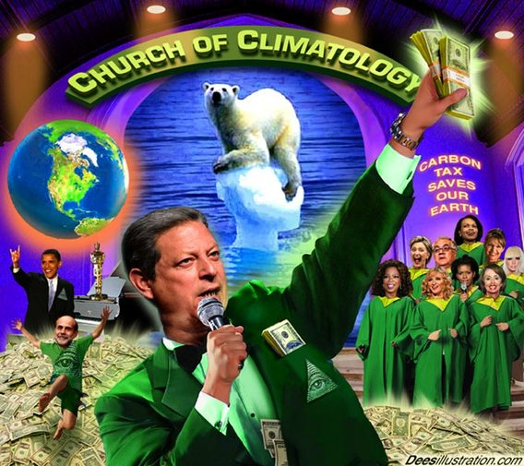

Slide 44
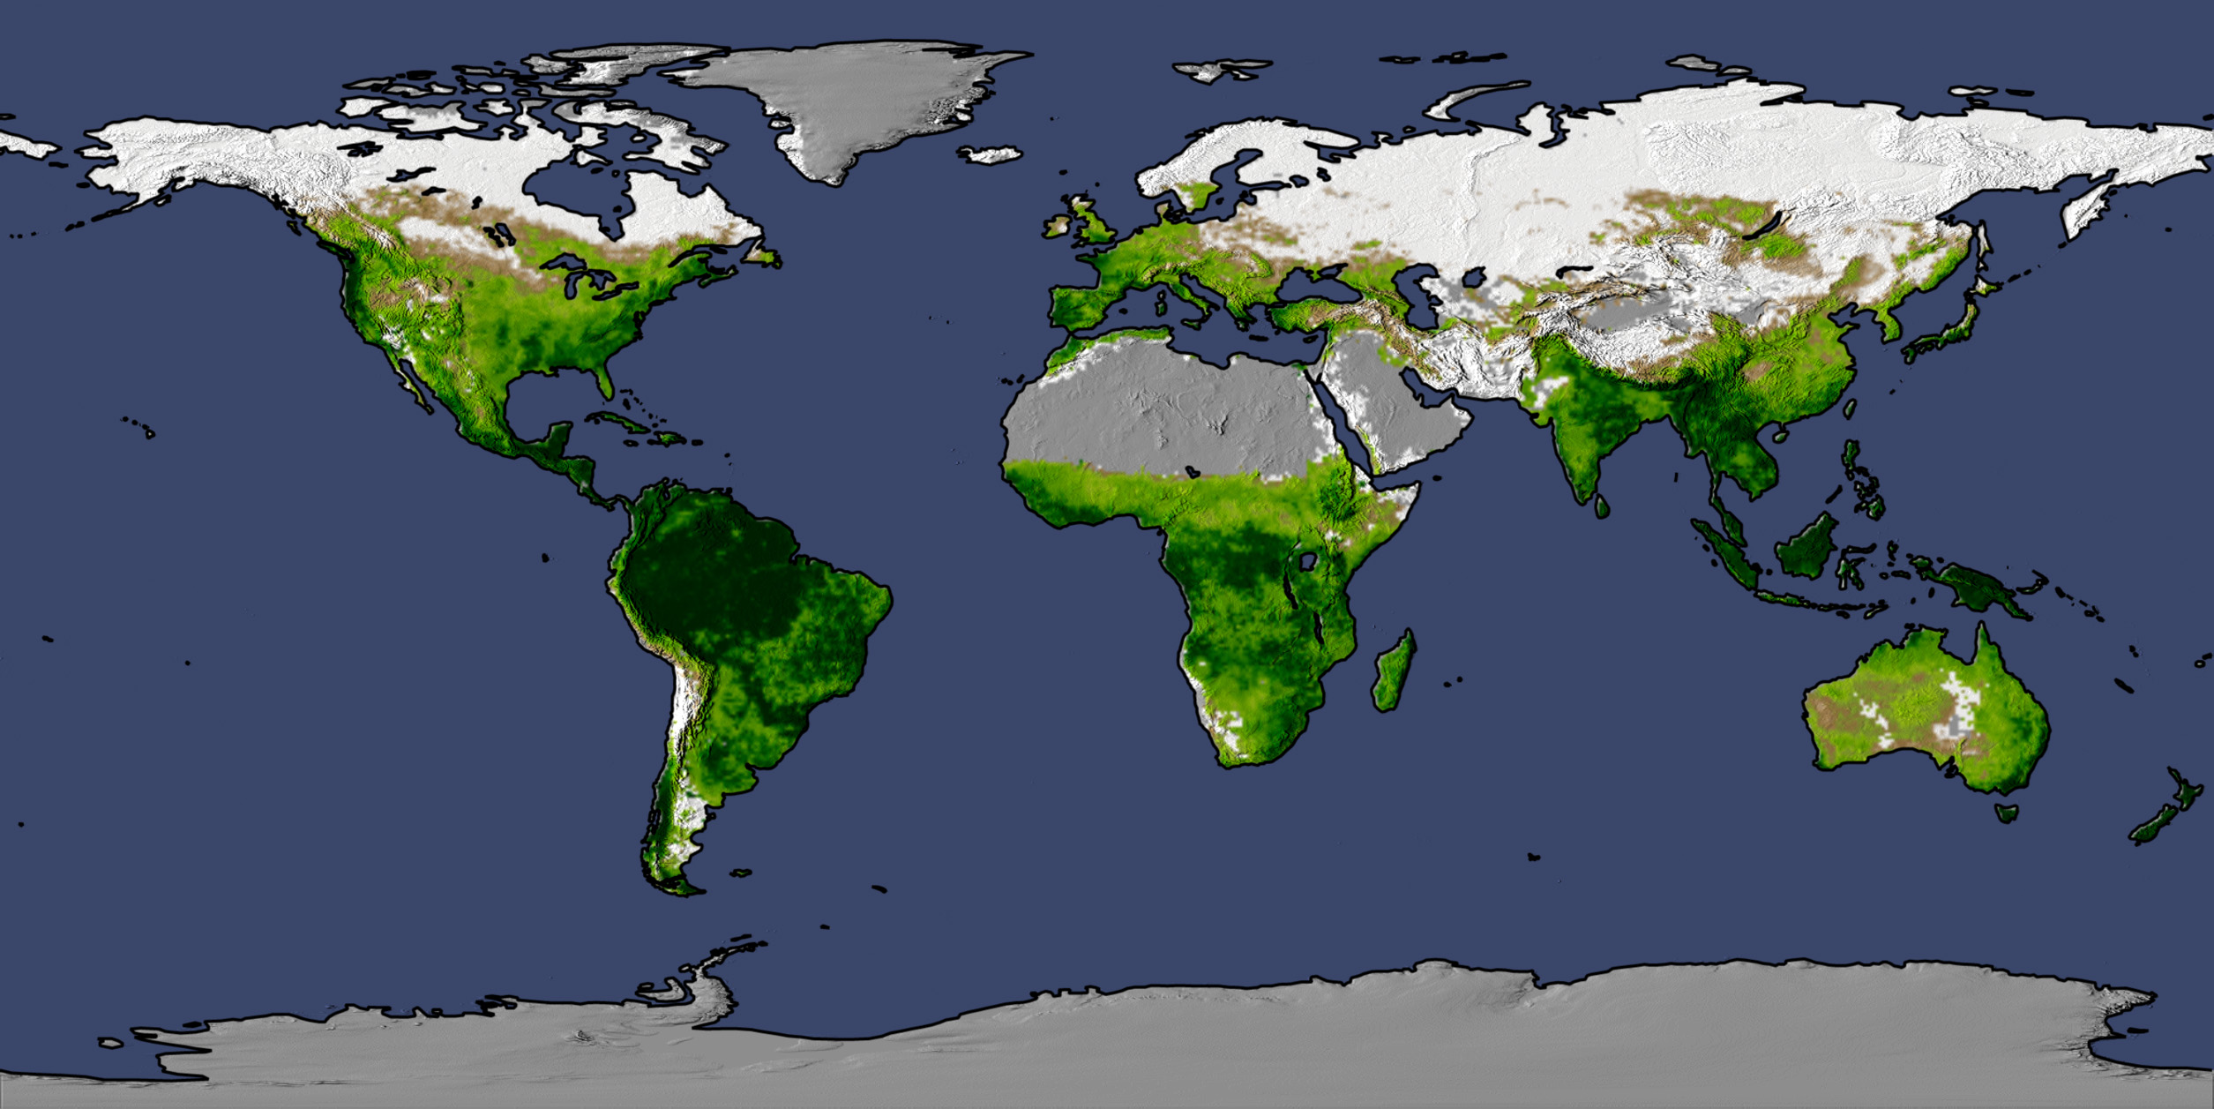

Slide 45
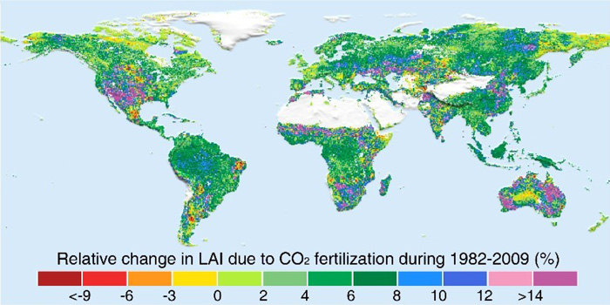

Slide 46
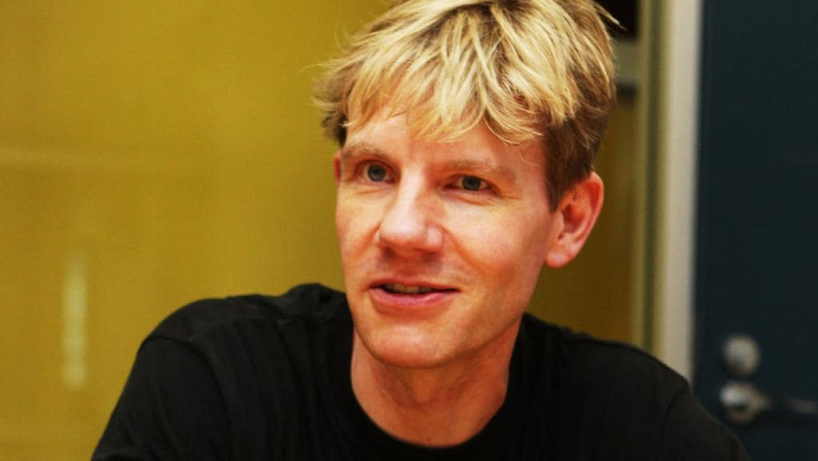
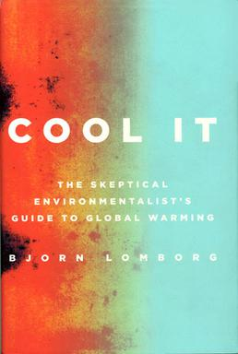

Slide 47
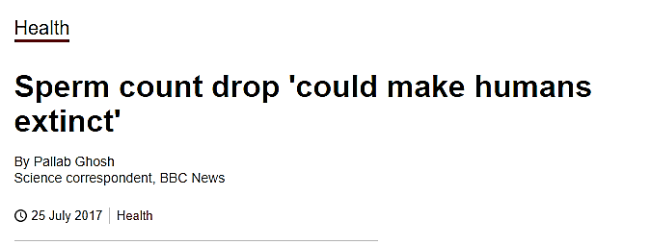

Slide 48
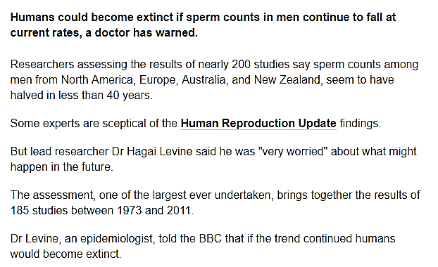

Slide 49
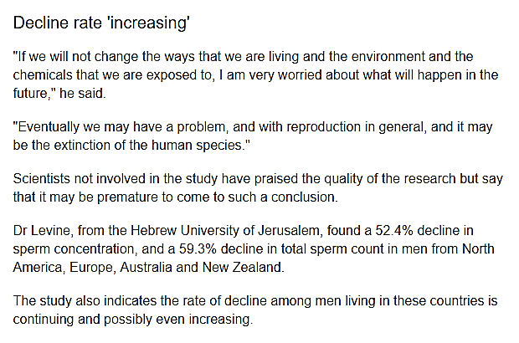

Slide 50
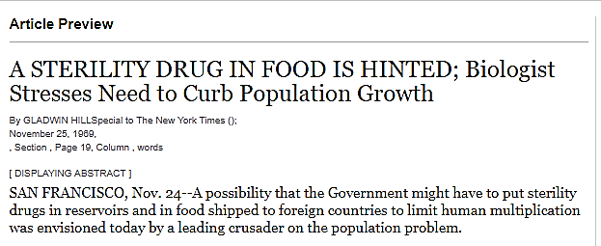

Slide 51
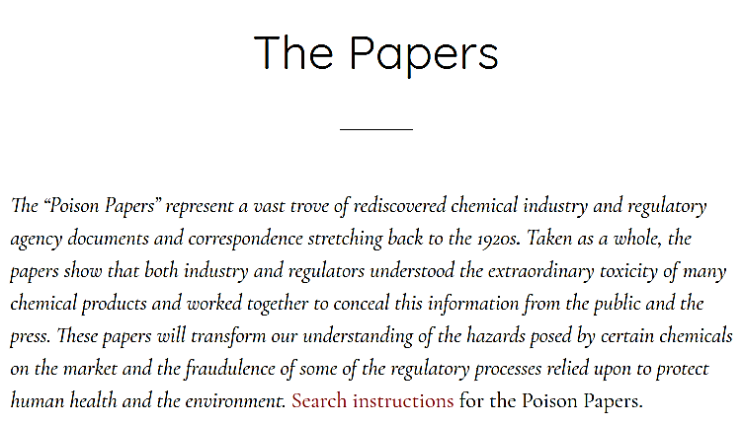

Slide 54
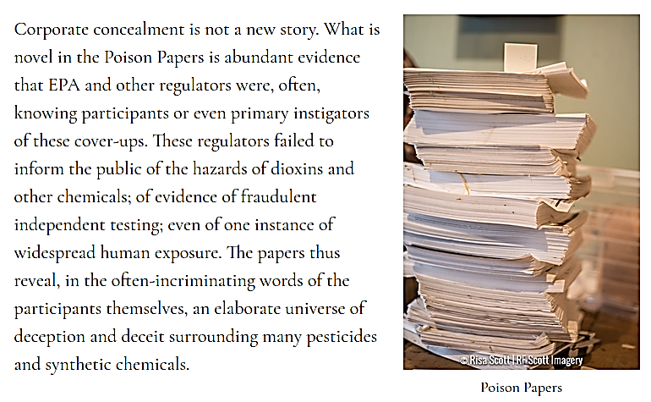

Slide 55
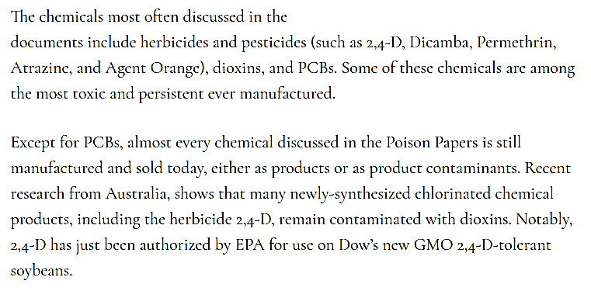

Slide 56
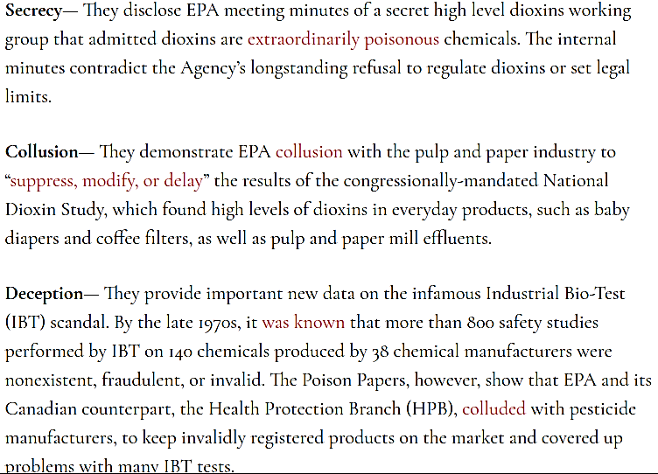

Slide 57
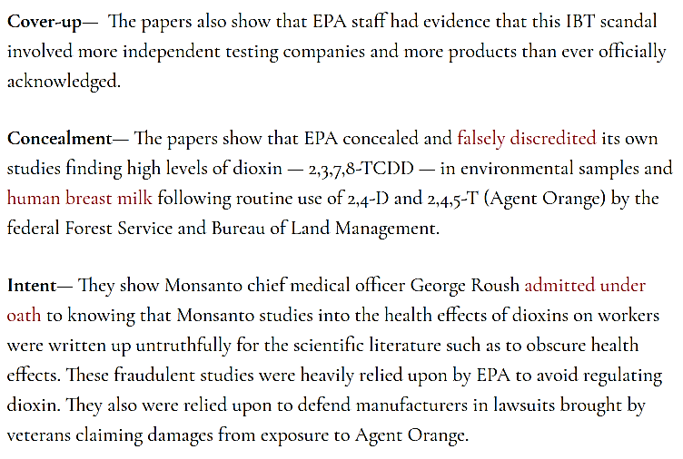

Slide 60
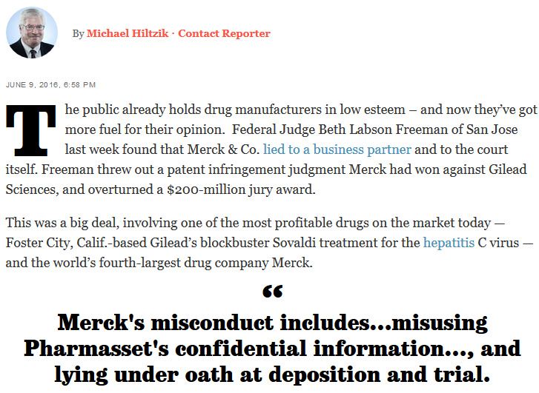

Slide 61
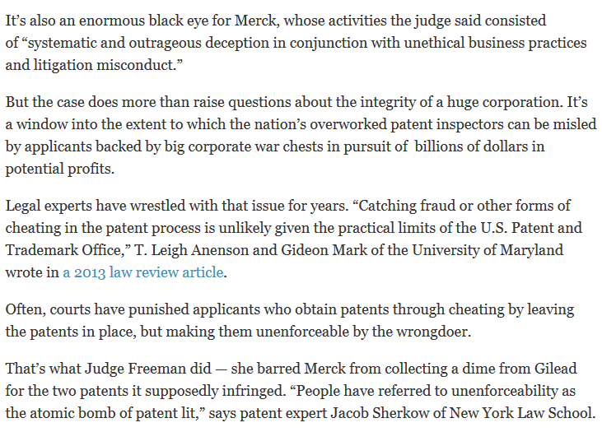
nnn

Slide 64
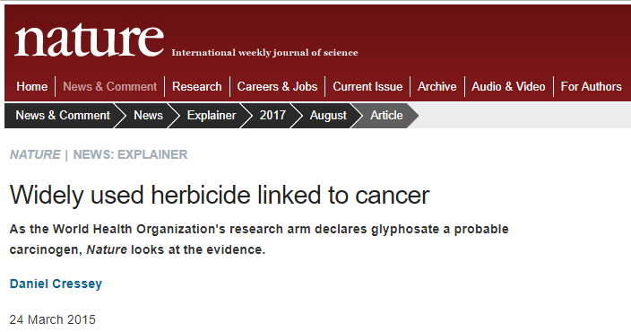

Slide 66
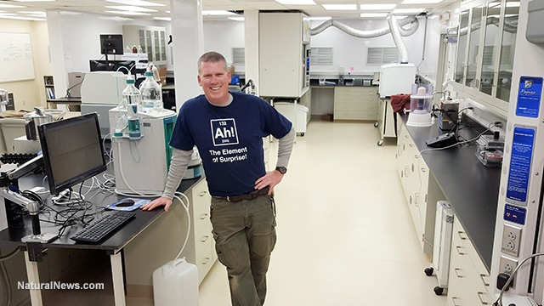

Slide 67
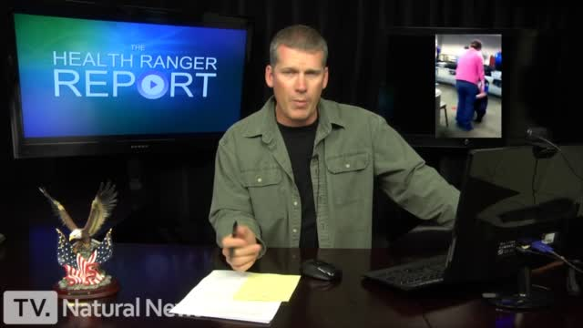
Results of Independent Analysis
After having now analysed over 1,000 foods, superfoods, vitamins, junk foods and popular beverages for heavy metals and other substances at the Natural News Forensic Food Labs,
I have arrived at a conclusion so alarming and urgent that
it can only be stated bluntly.

Slide 68
The food supply appears to be intentionally designed to end human life rather than nourish it.

Slide 69
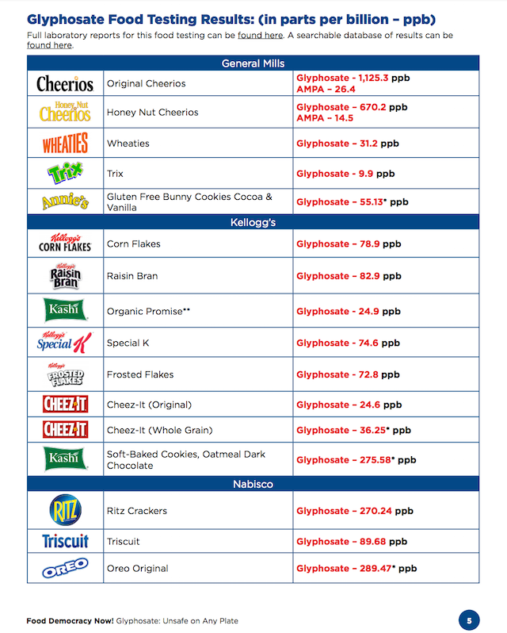

Slide 70
Battle for food safety almost lost
Based on what I am seeing via atomic spectroscopy analysis of all the dietary substances people are consuming on a daily basis,
I must now announce that the battle for
humanity is nearly lost.

Slide 86
Diet, injections, and injunctions, will combine from a very early age, to produce the sort of character the authorities consider desirable. Bertrand Russell, The Impact of Science on Society, 1953.

Slide 92
Vaccinations cause ‘spontaneous abortions’
Tetanus vaccines given to millions of young women in Kenya have been confirmed by laboratories to contain a sterilization chemical that causes miscarriages.
Kenya Catholic Doctors Association. (pro-vaccine organization).

Slide 99
The Weather has
been Weaponized

Slide 100
We shall propose further cooperative efforts between all nations in weather predictions and eventually
weather control.
J. K. Kennedy
Sept. 25, 1961.
Weather Control

Slide 103
Weather modification will become a part of domestic and international security and could be done unilaterally…
It could have offensive and defensive applications and even be used for deterrence purposes.

Slide 104
The ability to generate precipitation,
fog and storms on earth or to modify space weather…
and the production of artificial weather all are
a part of an integrated set of [military] technologies.
US Air Force document AF 2025 Final Report.

Slide 105
The air we breathe has
been weaponized

Slide 115
Weather modification programs already in existence in 1977
…weather modification
programs – have been housed and supported within executive
departments, agencies,
or offices.

Slide 121
High Frequency Active Auroral Research Program
(HAARP)

Slide 127
Dispersed metallic particles such as aluminium,
barium and strontium may increase the atmosphere’s conductivity and therefore enhance HAARP’s weather modification performance.
HAARP Patent document.

Slide 130
The character of the Open Conspiracy will now be plainly displayed. It will have become a great world movement as widespread and evident as socialism or communism. It will largely have taken the place of these movements. It will be more, it will be a world religion. This large loose assimilatory mass of groups and societies will be definitely and obviously attempting to swallow up the entire population of the world and become the new human community.
H.G. Wells, The Open Conspiracy, 1928.

Slide 131
There will be a universal bond of union, one great harmony, a confederacy of Satan's forces. Maranatha p. 187.

Slide 133
Our Conquering King
And he hath on his vesture and on his thigh a name written,
King Of Kings, And Lord Of Lords.
Rev. 19:16.

Slide 134
The Last Battle
And I saw the beast, and the kings of the earth, and their armies, gathered together to make war against him that sat on the horse, and against his army. Rev. 19:19.

Slide 135
The Beast and his followers defeated
And the beast was taken,
and with him the false prophet that wrought miracles before him, with which he deceived them that had received the mark of the beast, and them that worshipped his image.
These both were cast alive into a lake of fire burning with brimstone.
Rev. 19:20.

Slide 136
All Enemies are destroyed
And the remnant were slain with the sword of him that sat upon the horse, which sword proceeded out of his mouth: and all the fowls were filled with their flesh.
Rev. 19:21.

