Slide 1
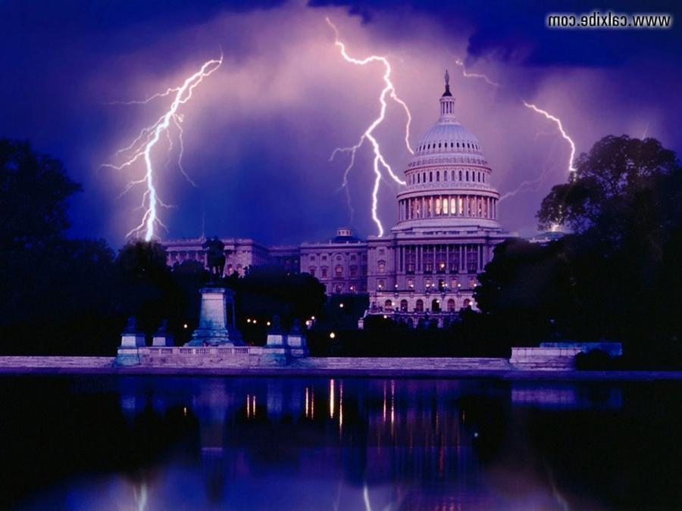
Current Events and Bible Prophecy

Slide 2
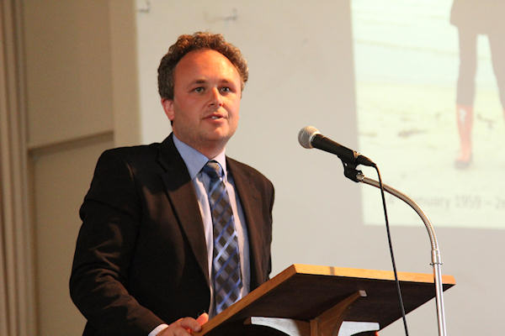

Slide 3
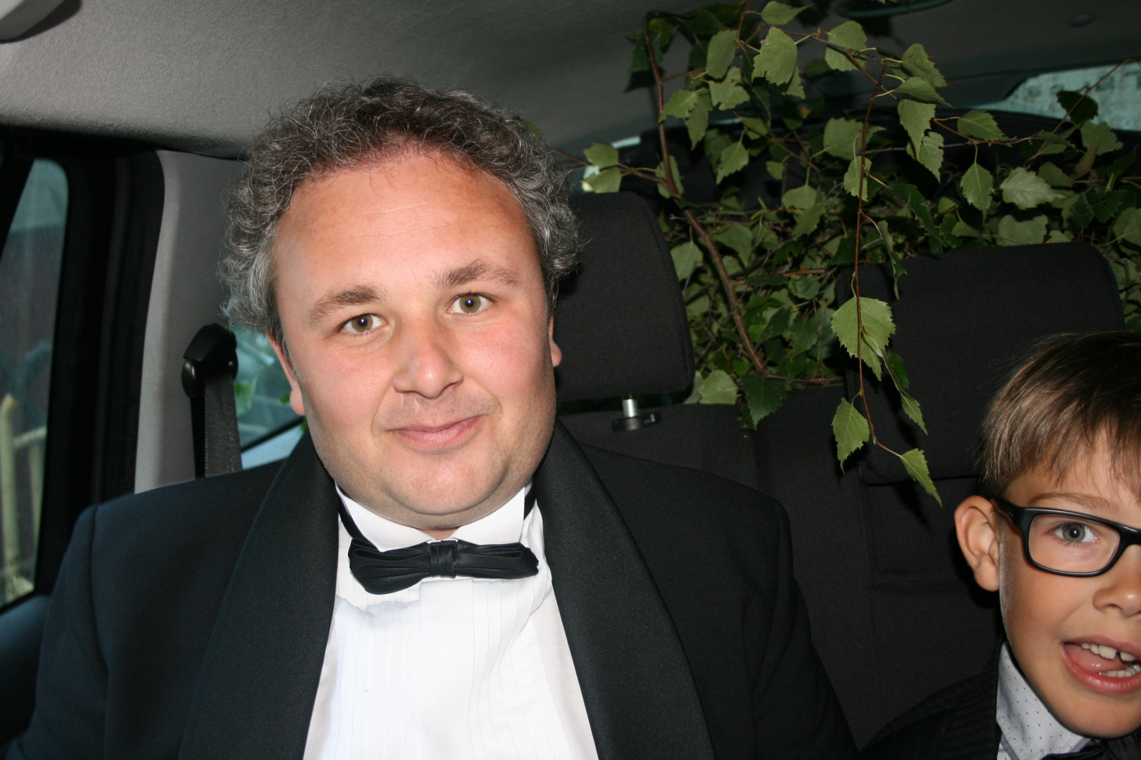

Slide 4
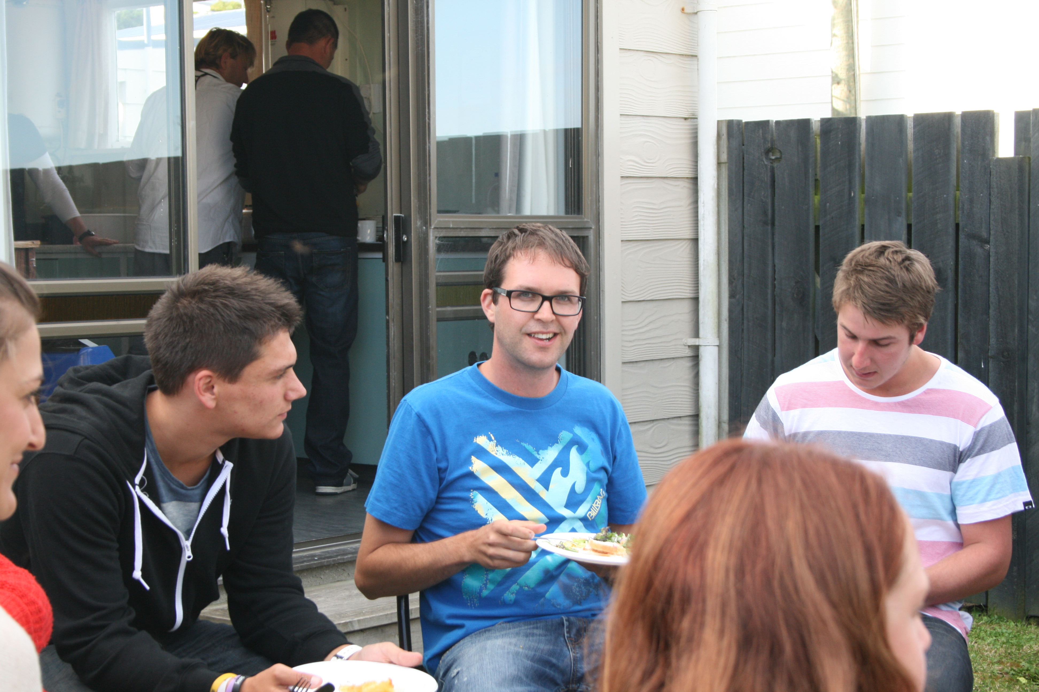

Slide 5


Slide 6
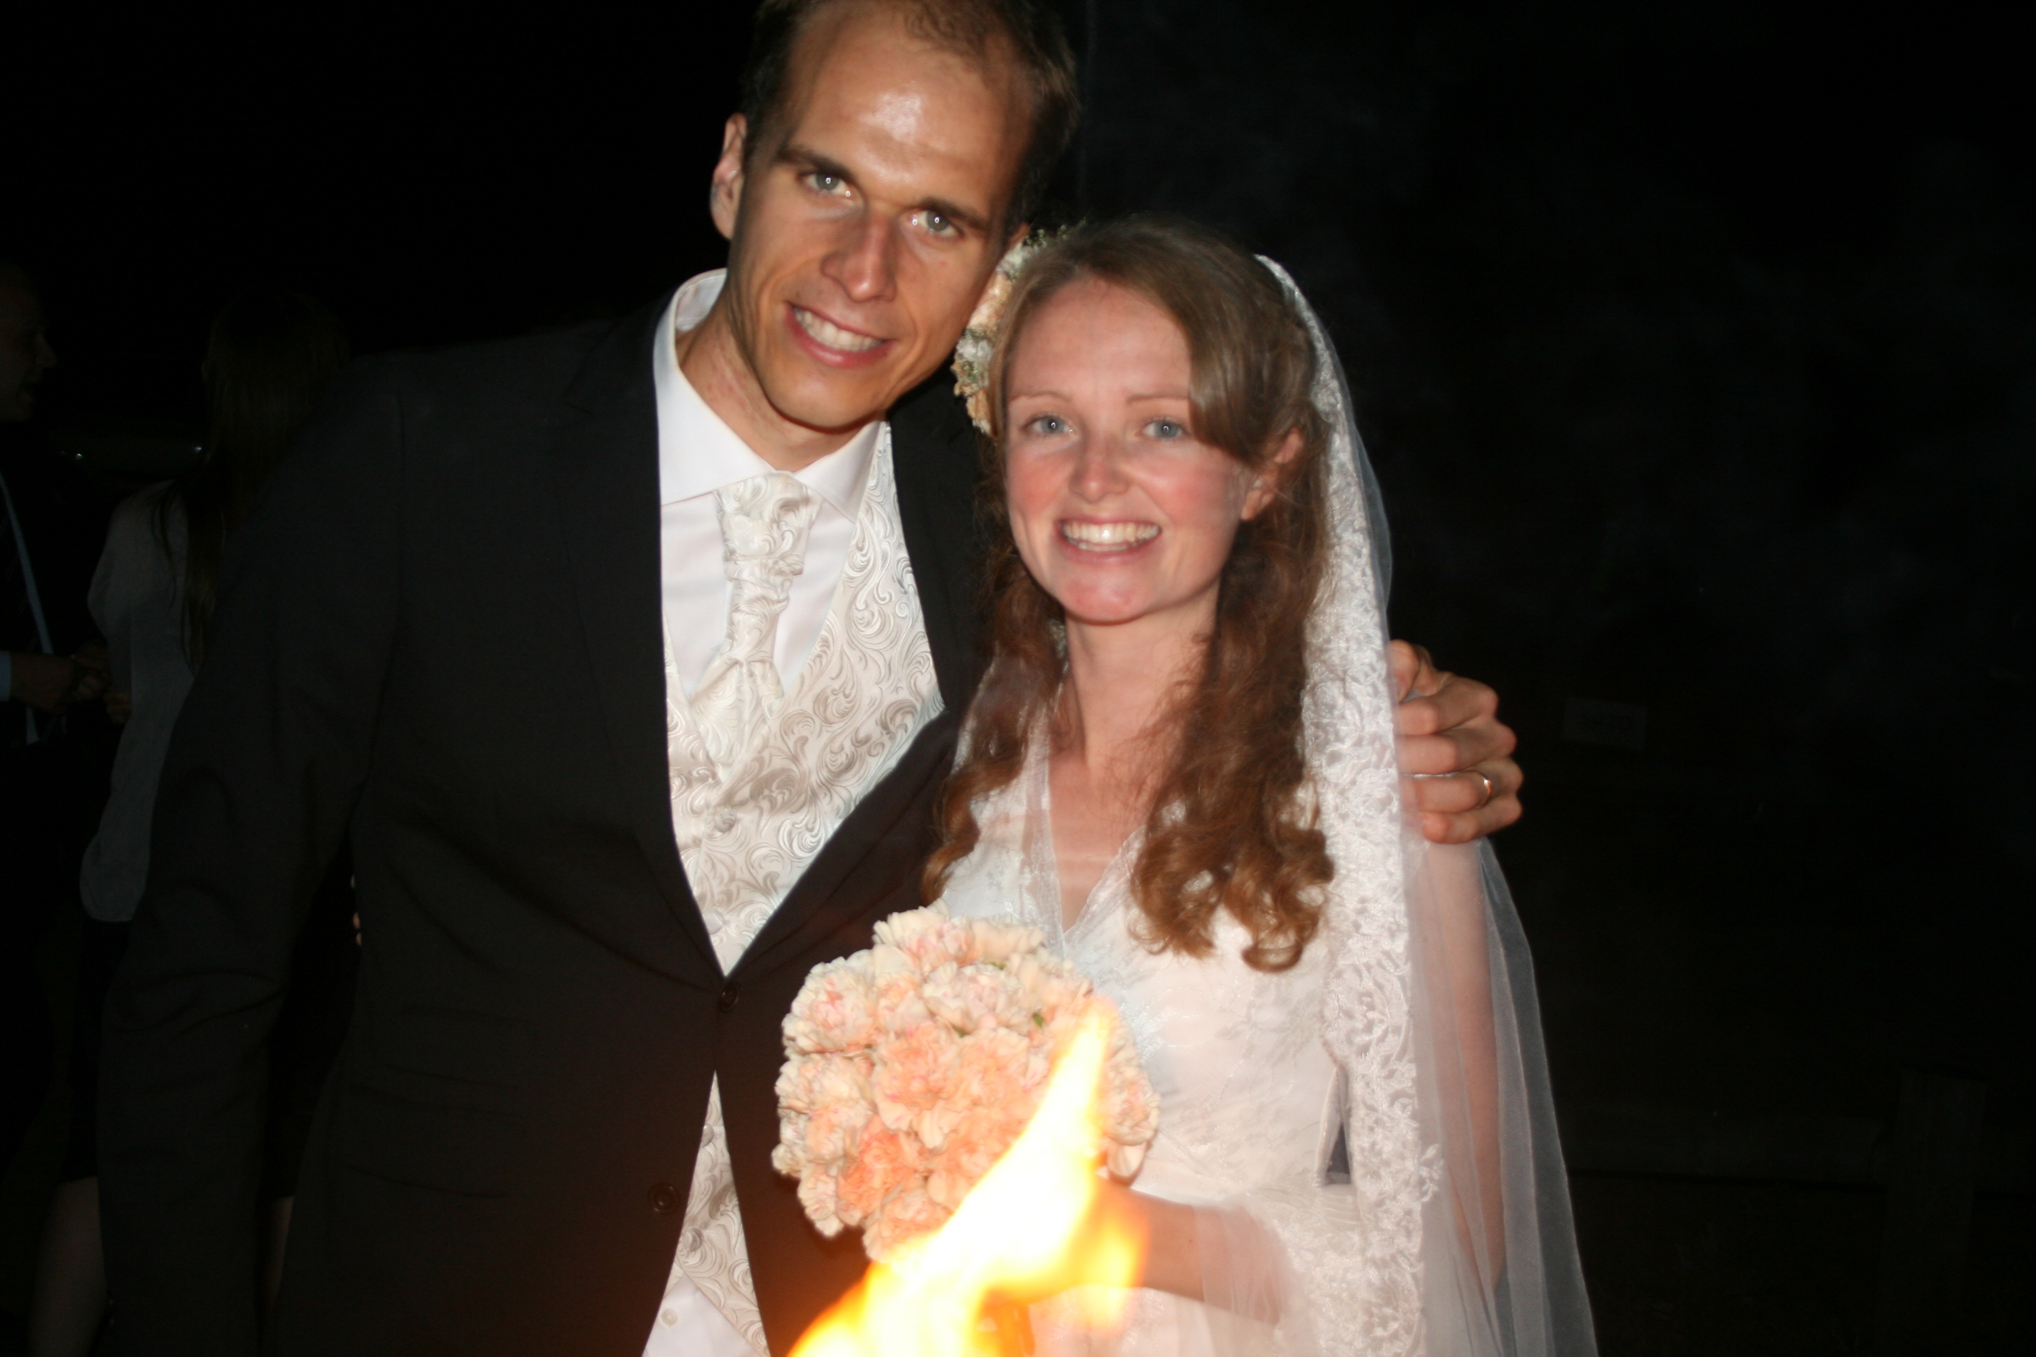

Slide 7


Slide 8
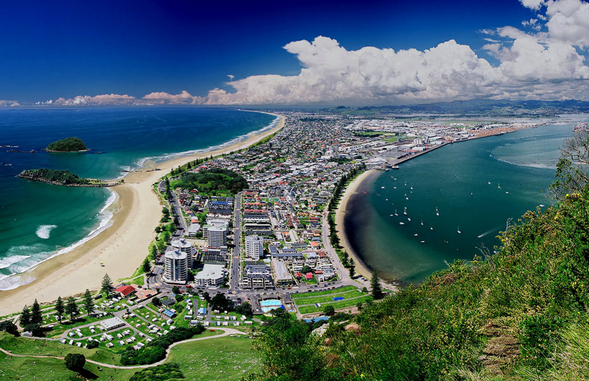

Slide 9
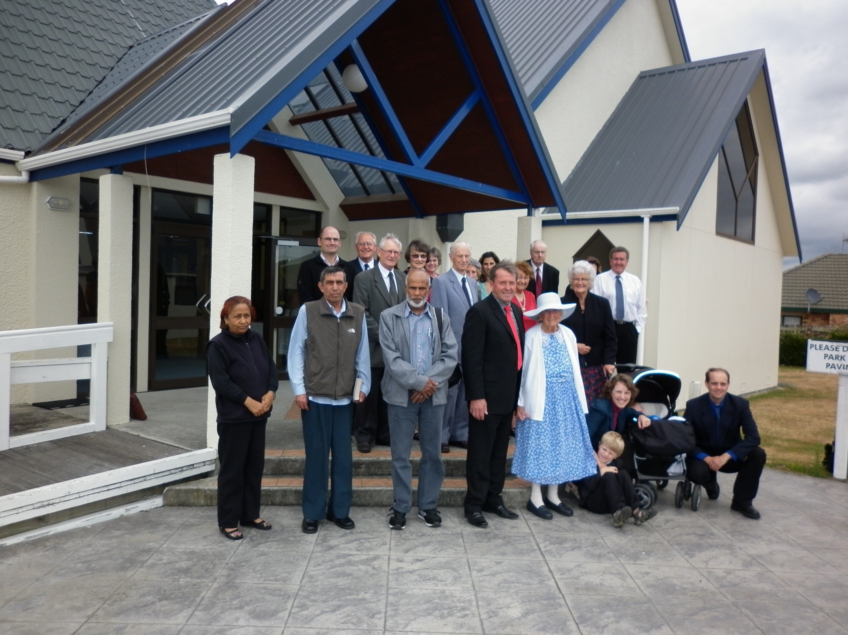

Slide 10
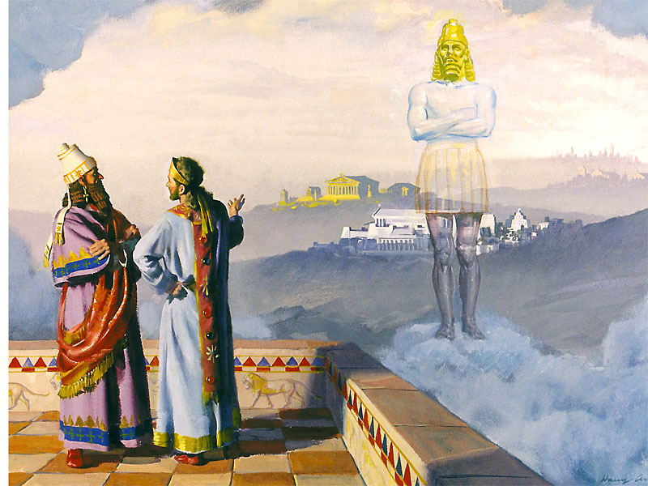

Slide 11
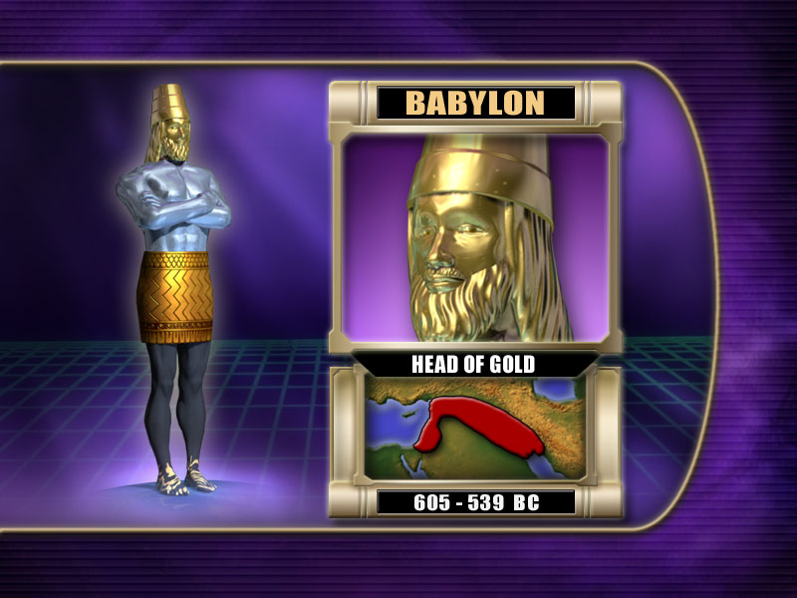

Slide 12
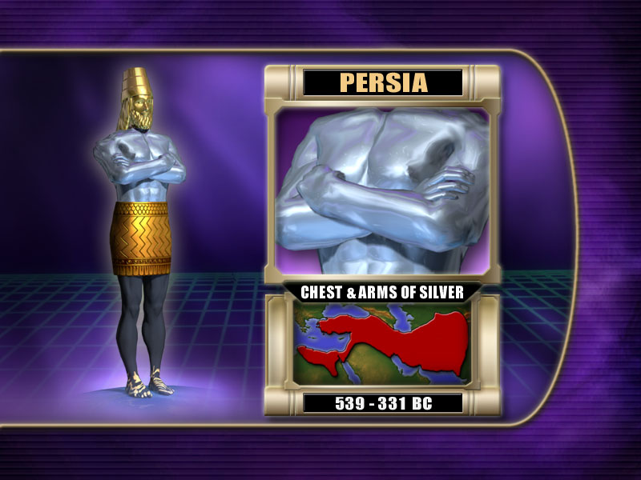

Slide 13
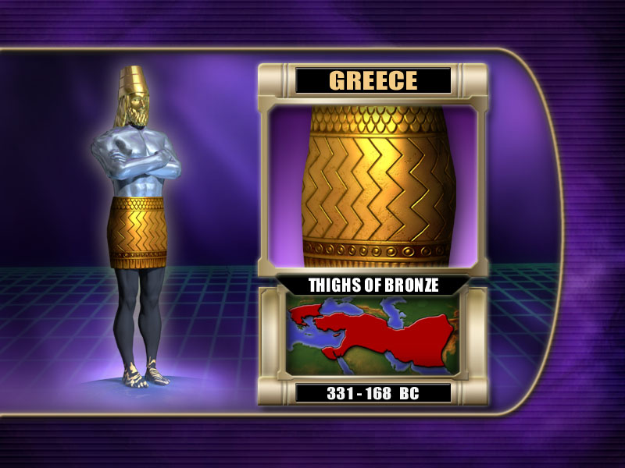

Slide 14
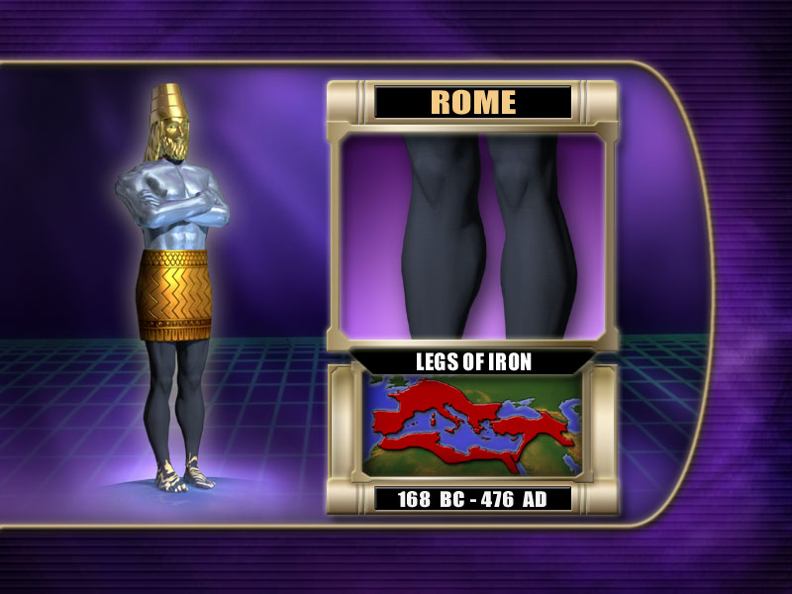

Slide 15
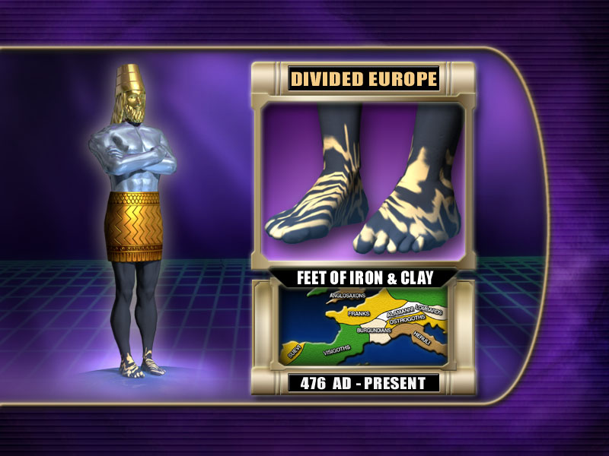

Slide 16
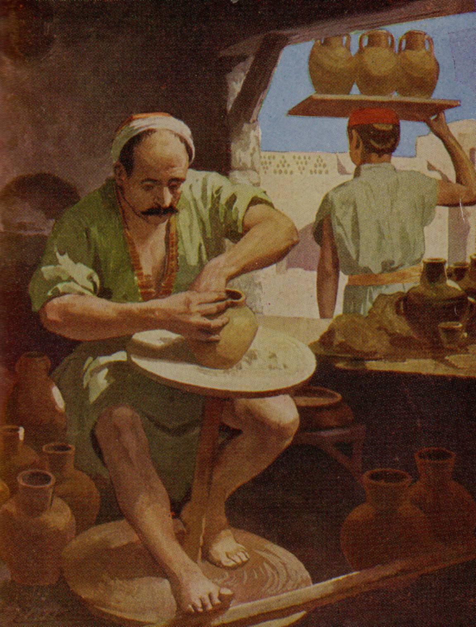
The word which came to Jeremiah from the Lord, saying, Arise, and go down to the potter's house, and there I will cause thee to hear my words. Then I went down to the potter's house, and, behold,
he wrought a work on the wheels.
And the vessel that he made of clay was marred in the hand of the potter: so he made it again another vessel, as seemed good to the potter to make it. Jer. 18:1-4.

Slide 17
God’s people are the Clay
Then the word of the Lord came to me, saying,
O house of Israel, cannot I do with you as this potter? saith the Lord. Behold, as the clay is in the potter's hand, so are ye in mine hand, O house of Israel. Jer. 18:5, 6.

Slide 18
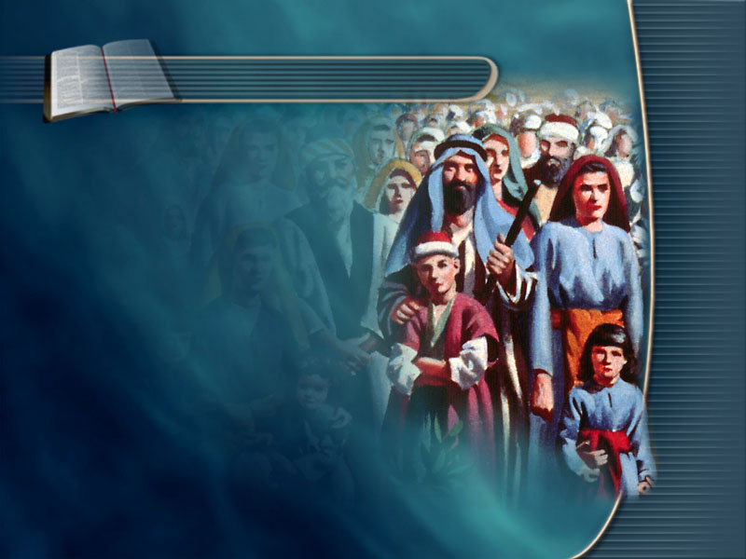
Isa. 64:8.
O Lord, thou art our father; we are the clay,
and thou our potter;
and we are the work
of thy hand.
God’s people are the Clay

Slide 19
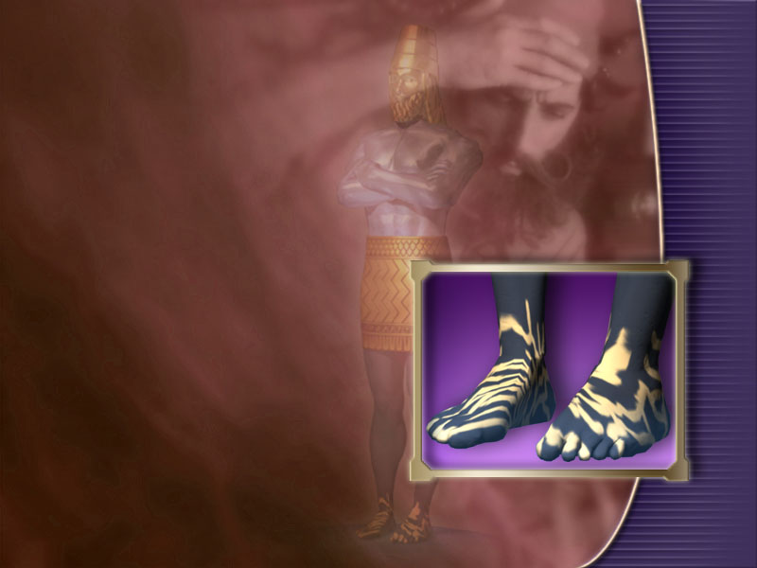
We are in the Kingdom of
Iron and Clay
We have come to a time when God’s sacred work is represented by the feet of the image in which the iron was mixed with the miry clay…

Slide 20
The Union of Church and State
The mingling of churchcraft and statecraft is represented by the
iron and the clay.

Slide 21
Union of Church and State
creates weak Churches
This union is weakening
all the power of the churches.
And as the toes of the feet were part of iron, and part of clay,
so the kingdom shall be partly strong, and partly broken (weak).
Dan. 2:42.

Slide 22
Union brings evil results
This investing the church with the power of the State will bring evil results. Men have almost passed the point of God’s forbearance. They have invested their strength in politics, and have united
with the papacy.
MS 63 1899. SDA Bible Commentary, vol. 4, p. 1168-1169.

Slide 23
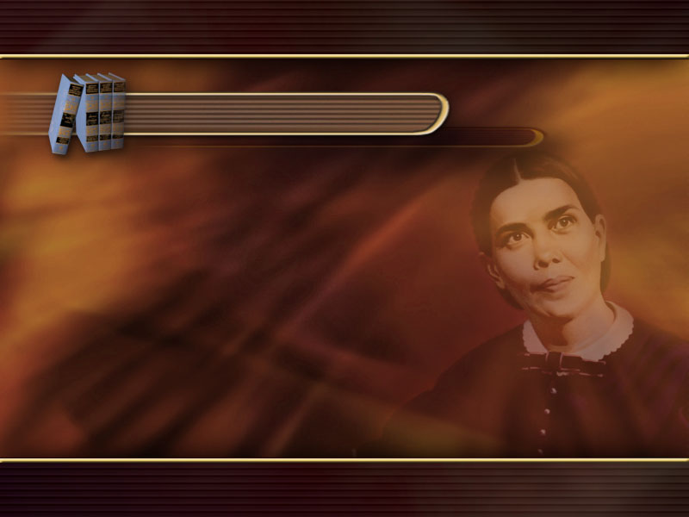
Union of Church and State created the Papacy
GC 443
When the early church became corrupted by departing from
the simplicity of the gospel, and accepting heathen rites and customs, she lost the Spirit and power of God; and in order to control the consciences of the people she sought the support of the secular power. The result was the papacy, a church that controlled the power of the State, and employed it to further
her own ends, especially for the punishment of “heresy.”

Slide 24

Church and State work together
to achieve Papal Supremacy
Vigilius... ascended the papal chair (538 A.D.) under the military protection of Belisarius. History of the Christian Church, Vol. 3, p. 327.

Slide 25
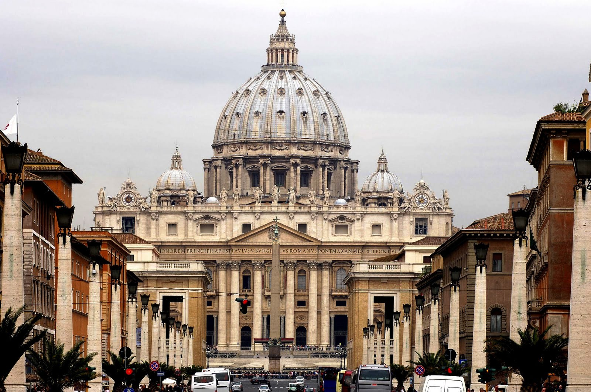
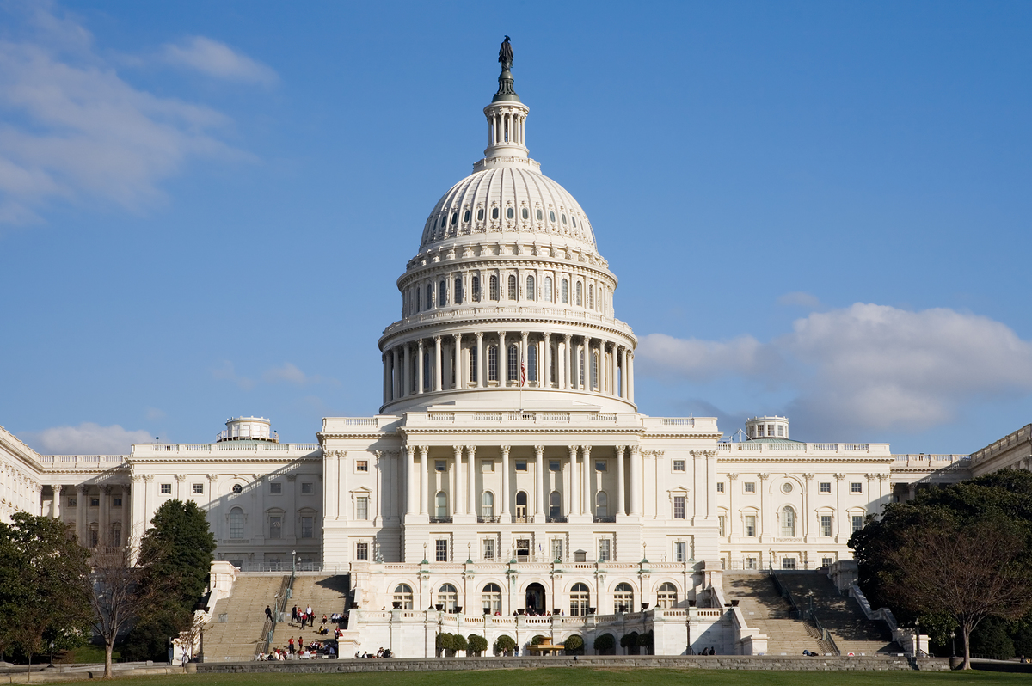
Church
State

Slide 26
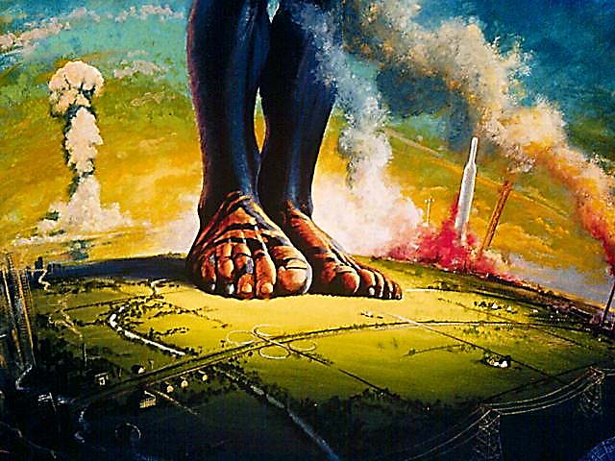
Rome
Rome continues to the end of time
Rome metamorphoses into the Papacy
The Papacy is a Union of Church and State

Slide 27
…the empire has not perished,
but has only undergone a transformation…

Slide 28
That is no mere “clever remark,” but the recognition of the true state of the matter historically, and the most appropriate and fruitful way of describing the character of this Church.

Slide 29
Adolf Harnack,
What Is Christianity?
(2d ed., rev.; New York:
Putnam, 1901),
pp. 269, 270.
It still governs the nations… It is a political creation, and as imposing as
a World-Empire, because it is the continuation of the Roman Empire. The Pope, who calls himself “King”
and “Pontifex Maximus,” is Caesar’s successor.

Slide 30
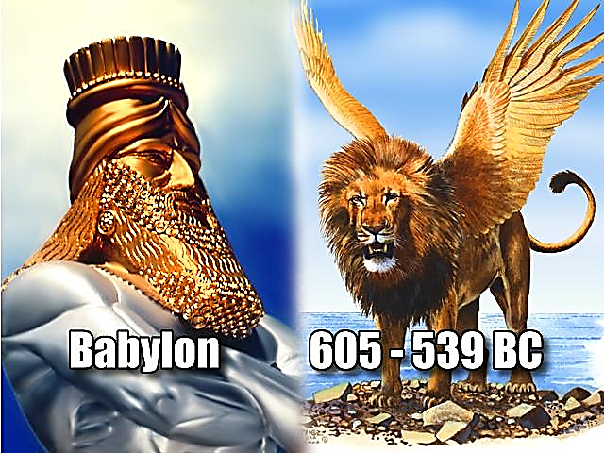
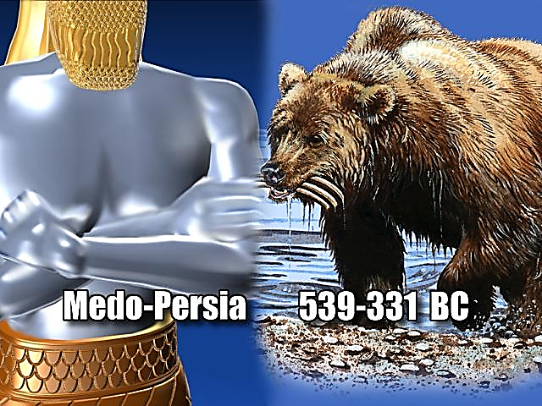
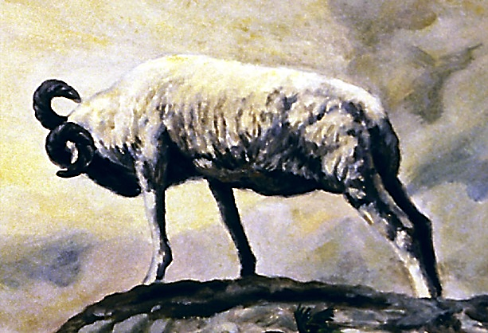
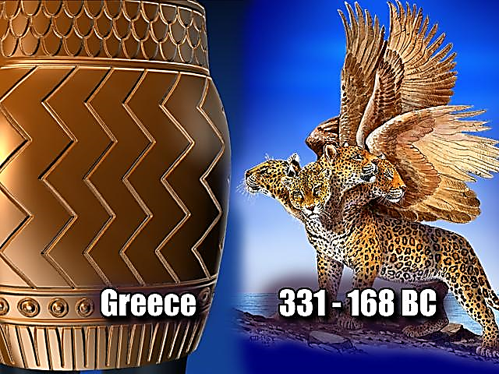
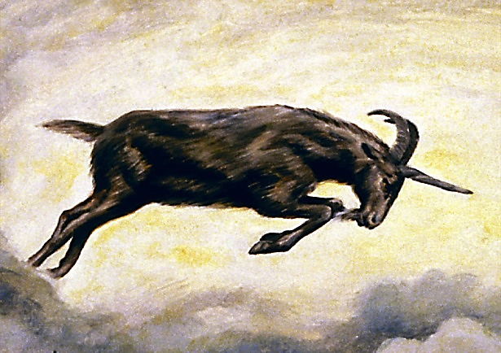
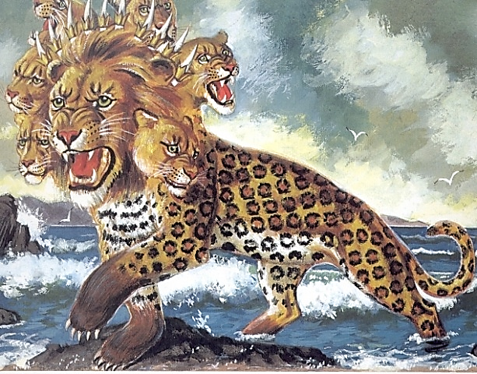
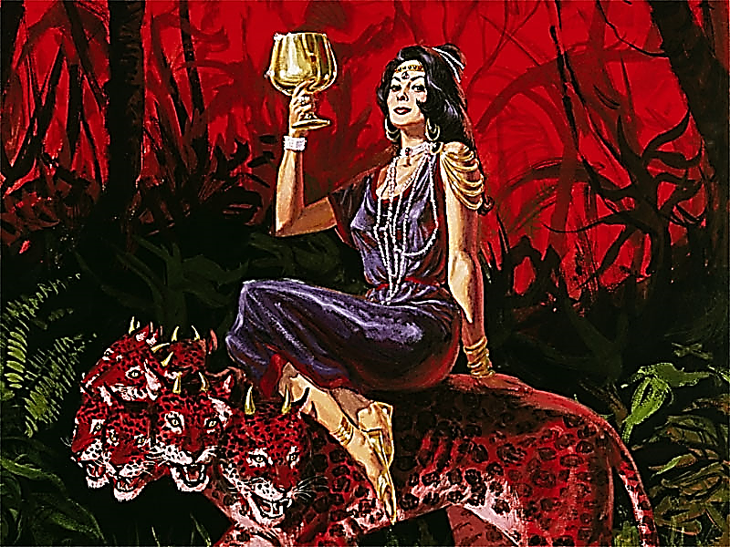
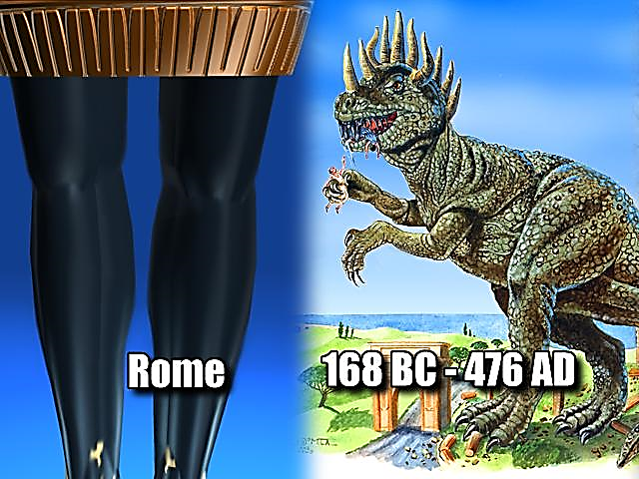
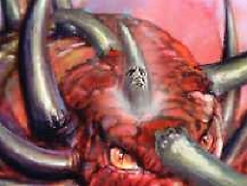
Daniel 8
Babylon drops out
Repeat and Enlarge Daniel & Revelation
As concerning the rest of the beasts, they had their dominion taken away: yet their lives were prolonged for a season and time. Dan. 7:12.
Rev. 13.
Rev. 17.

Slide 31
…having seven heads and ten horns,
and upon his horns ten crowns,
and upon his heads the
name of blasphemy.
Rev. 13:1.

Slide 32
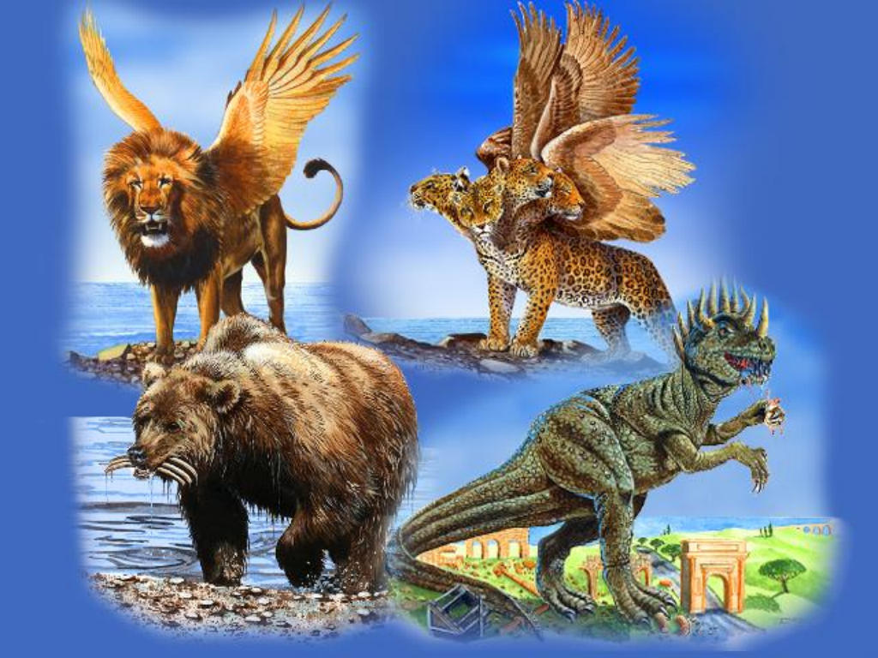

Repeat and Enlarge
Crowns on the horns
Seven heads
Names of Blasphemy
Lion
Leopard
Bear
Beast with 10 horns

Slide 33
…and the dragon gave him
his power,
and his seat,
and great authority.
Rev. 13:2.
.

Slide 34
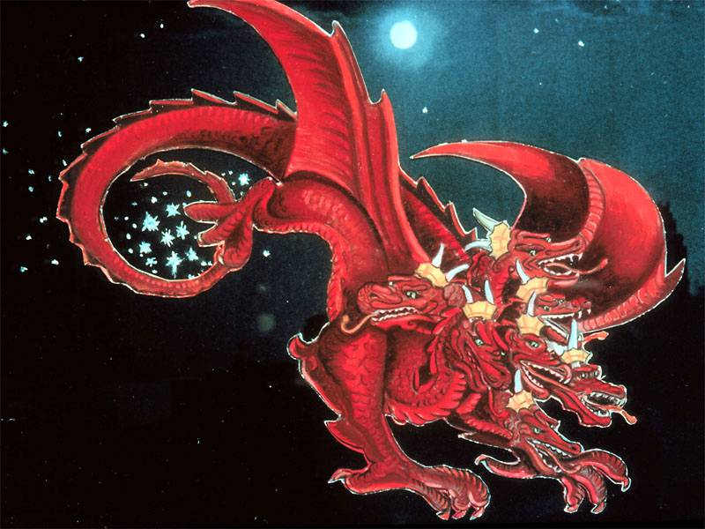
And the great dragon is Satan, that ancient serpent, also called the devil… Rev. 12:9.
Who is the Dragon?

Slide 35

…and the dragon gave him his power,
and his seat, and great authority. Rev. 13:2.
What is Satan’s Power?

Slide 36
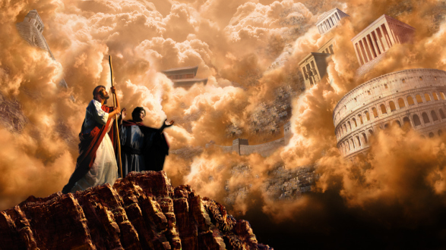
What is Satan’s Power?
And the devil, taking him up into an high mountain, shewed unto him all the kingdoms of the world in
a moment of time.
Lu. 4:5.

Slide 37
Satan’s Power is his control over the World
And the devil said unto him,
all this power will I give thee,
and the glory of them:
for that is delivered unto me;
and to whomsoever I will I give it.
Lu. 4:6.

Slide 38
Why does Satan control the World?
And the devil said unto him,
all this power will I give thee,
and the glory of them:
for that is delivered unto me;
and to whomsoever I will I give it.
Lu. 4:6.

Slide 39
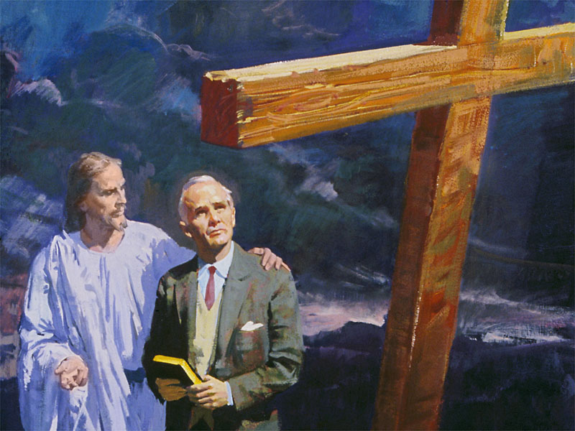
For we know that that the law is spiritual: but I am carnal, sold under sin.
Rom. 7:14.

Slide 40
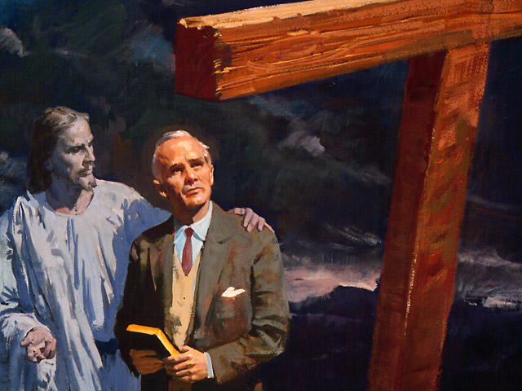
For I delight in the law of God
after the inward man:
but I see another law
in my members,
warring against the
law of my mind, and
bringing me into captivity
to the law of sin
which is in my members.
Rom. 7:22, 23.

Slide 41
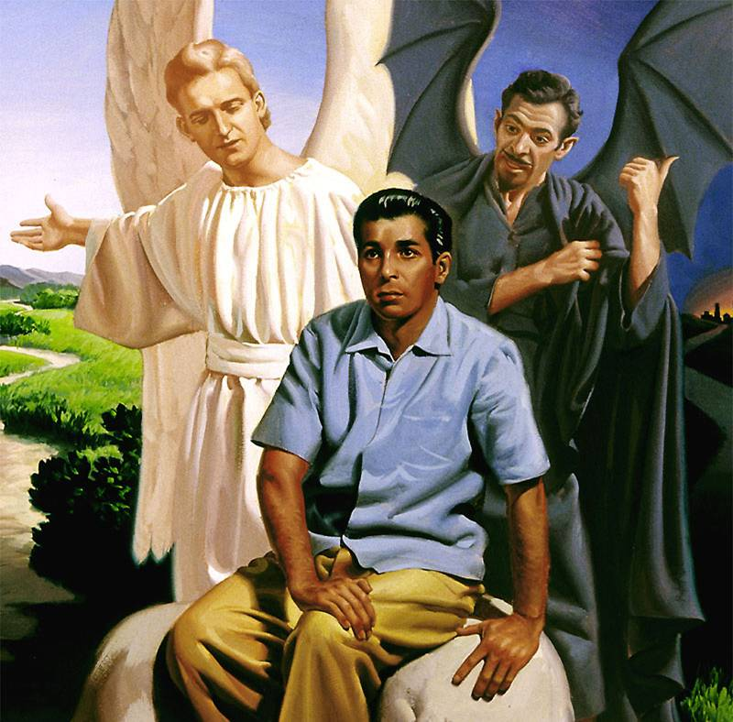
We choose to whom we give our Allegiance
The Scripture declares that the whole world is a prisoner of sin… Gal. 3:22 NKJV.
Know ye not, that to whom ye yield yourselves servants to obey, his servants ye are to whom ye obey; whether of sin unto death, or of obedience unto righteousness? Rom. 6:16.

Slide 42
We can only belong to one of two Kingdoms
Verily, verily, I say unto you,
Whosoever committeth sin is the servant of sin.
Jn. 8:34.
Of whom a man is overcome, of the same is he brought in bondage. 2 Pet. 2:19.

Slide 43
Satan’s power is proportionate to the evil committed
RH July 16, 1901.
As men depart further and further from God,
Satan is permitted to have power
over the children of disobedience.
He hurls destruction among men.
There is calamity by land and sea.
Property and life are destroyed by
fire and flood.

Slide 44
Satan’s power is proportionate to the evil committed
RH July 16, 1901.
As men depart further and further from God,
Satan is permitted to have power
over the children of disobedience.
He hurls destruction among men.
There is calamity by land and sea.
Property and life are destroyed by
fire and flood.

Slide 45
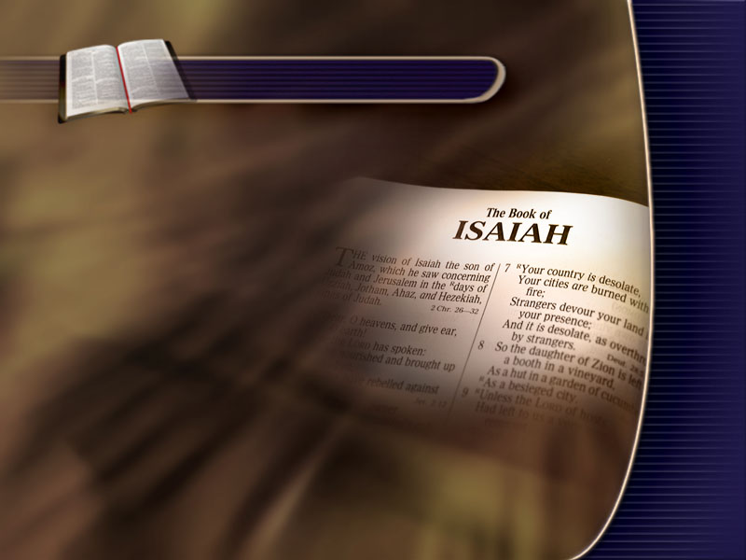
Isa. 49:24.
The Lawful Captive
Shall the prey be taken from the mighty, or the lawful captive delivered?

Slide 46
Isa. 49:25.
The Lawful Captives will be Delivered
But thus saith the Lord,
Even the captives of the mighty
shall be taken away, and the prey of the terrible shall be delivered:
for I will contend with him that contendeth with thee,
and I will save thy children.

Slide 47
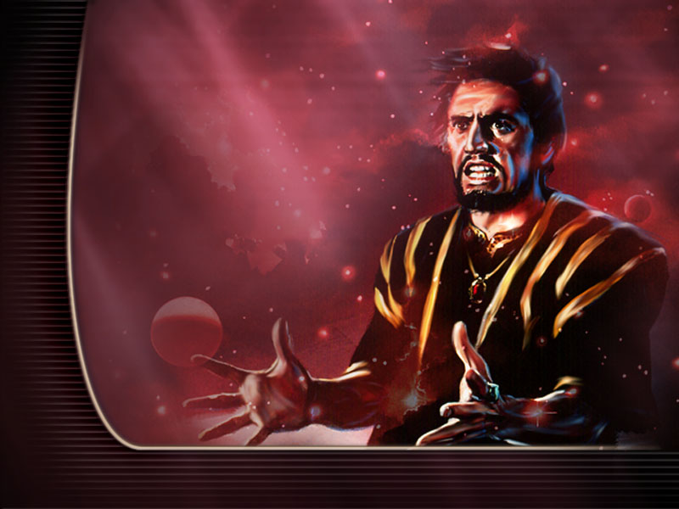
The Elect are
resisting his power
He numbers the world
as his subjects;
but the little company who keep the commandments
of God are resisting
his supremacy.

Slide 48
The Elect have to
be destroyed
If he could blot them
from the earth,
his triumph would
be complete.
GC 618.

Slide 49
Satan’s power given on condition of Worship
And the devil said unto him,
all this power will I give thee,
and the glory of them:
for that is delivered unto me;
and to whomsoever I will I give it.
If thou therefore wilt worship me,
all shall be thine.
Lu. 4:6, 7.

Slide 50
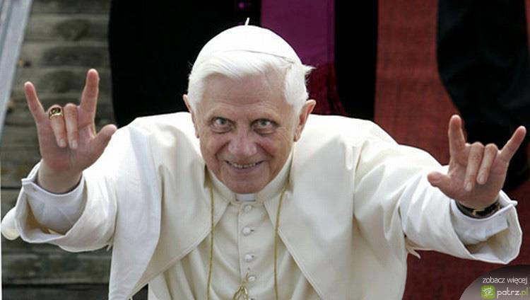
And they worshipped the dragon…
Rev. 13:4.

Slide 51
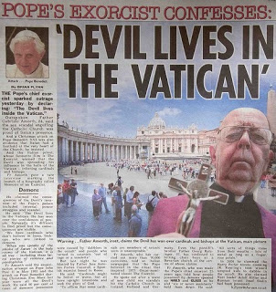

Slide 52
…and the dragon gave him his power,
and his seat, and great authority. Rev. 13:2.
What is Satan’s Seat?

Slide 53
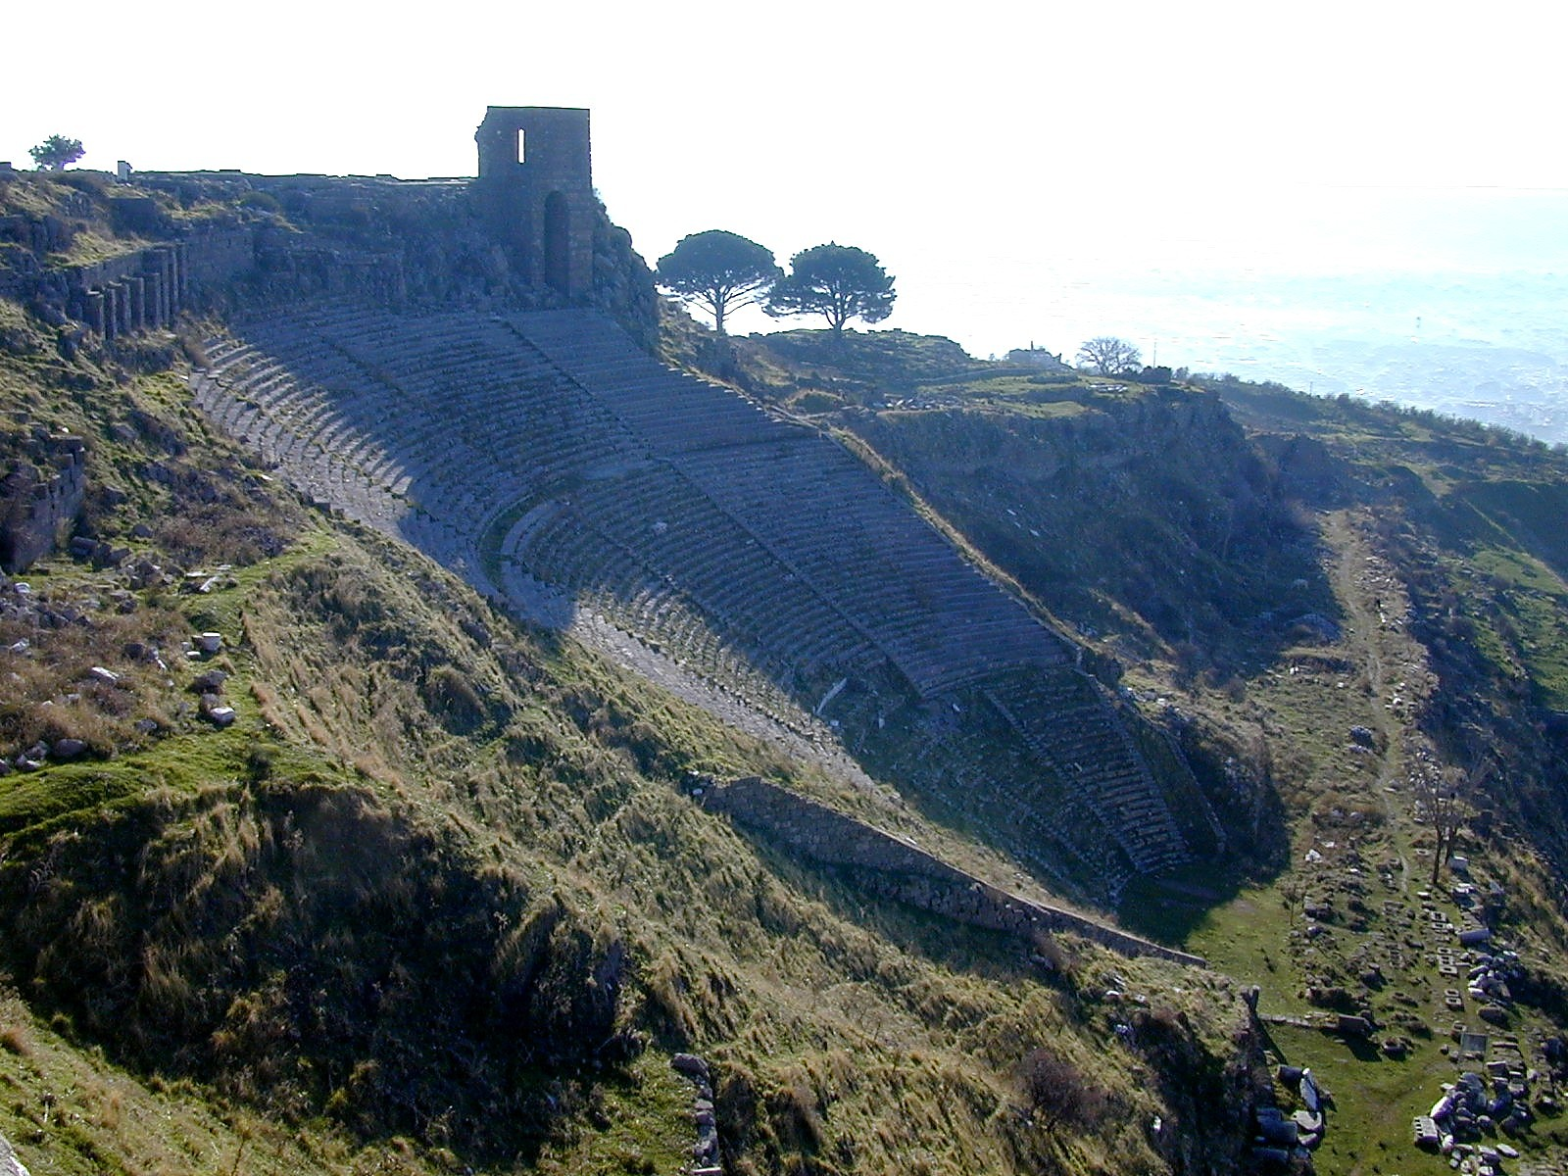
Pergamum was also the center of Oriental mystery religions transplanted from Mesopotamia (Babylon), and contained many pagan temples.
Its designation as the place “where Satan’s seat is” was thus appropriate indeed. SDABC vol. 7, p. 749.
I know thy works, and where thou dwellest (Pergamos), even where Satan’s seat is… where Satan dwelleth. Rev. 2:13.

Slide 54
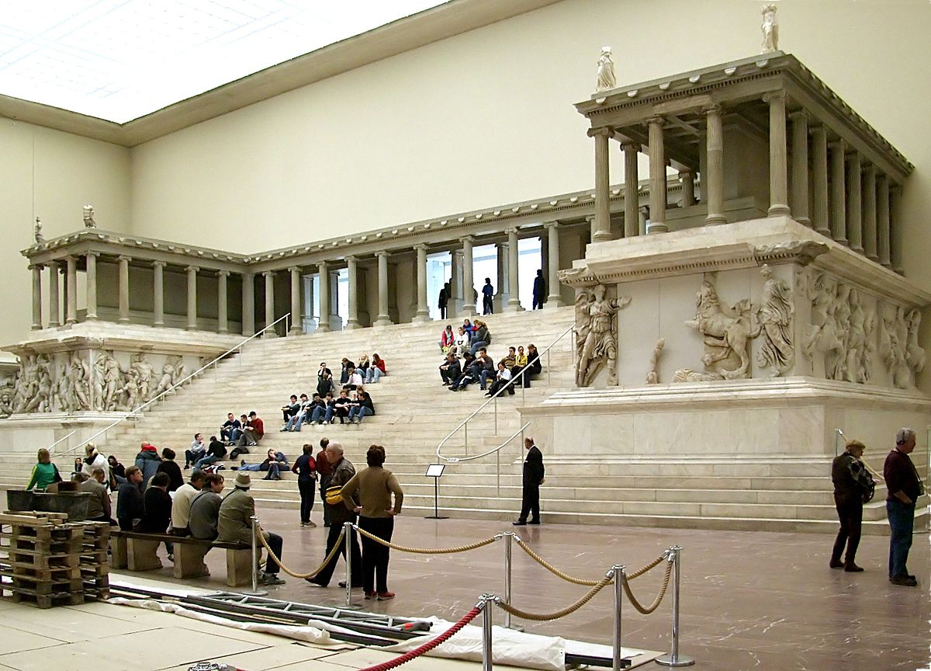

Slide 55
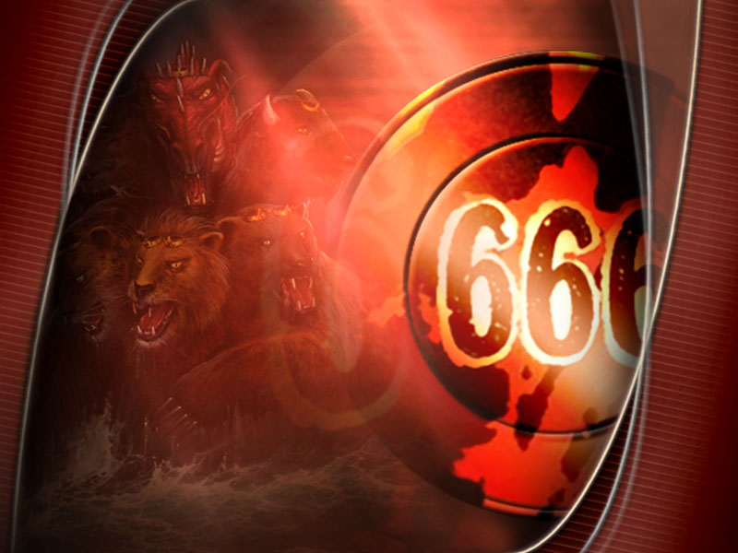
Babylon moved to Rome
The penetration of the religion
of Babylon became so general
and well known that Rome was
called the New Babylon.
Cardinal Gibbons, Faith of our Fathers
1917 ed. p. 106.

Slide 56
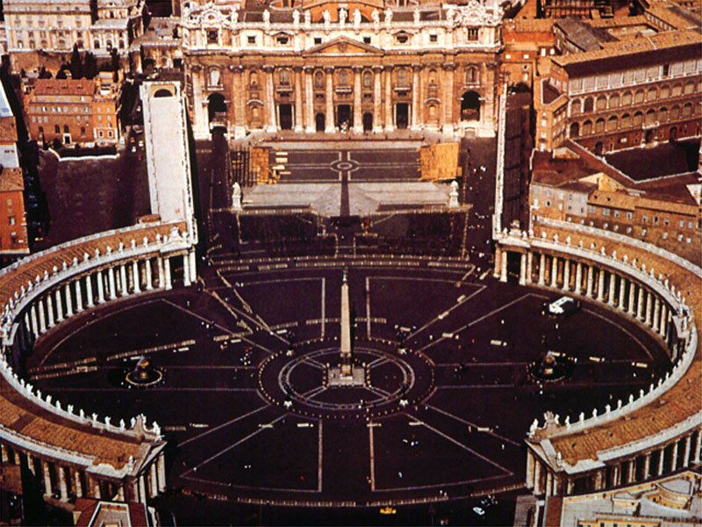
Satan’s Seat Today

Slide 57
…and the dragon gave him his power,
and his seat, and great authority. Rev. 13:2.
What Authority?

Slide 58
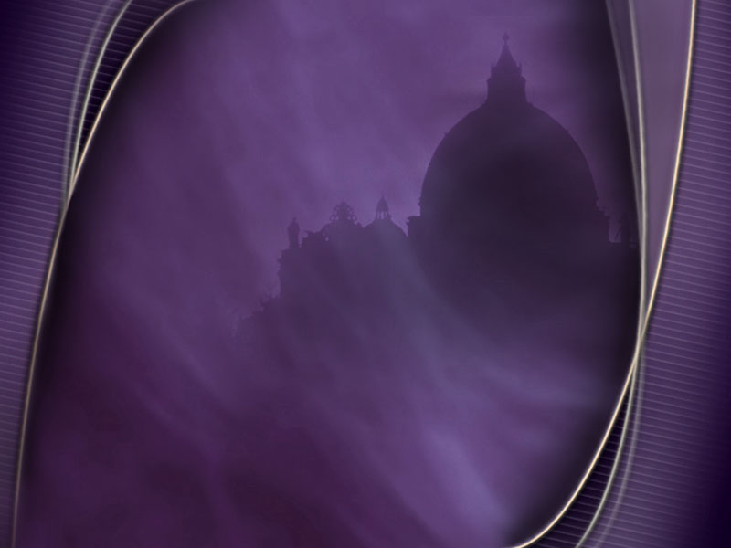
Unlimited Authority
The Pope's authority is unlimited,
incalculable; it can strike, as Innocent III says, wherever sin is; it can punish every one;
it allows no appeal and is itself Sovereign Caprice…
And he shall speak great words
against the most High… Dan. 7:25.
And there was given unto him a mouth speaking great things and blasphemies…
Rev. 13:5.

Slide 59
Infallible
…for the Pope carries, according to the
expression of Boniface VIII, all rights in the Shrine of his breast. As he has now become infallible, he can by the use of the little word, "orbi," (which means that he turns himself round
to the whole Church) make every rule,
every doctrine, every demand, into a certain
and incontestable article of Faith.

Slide 60
Pope’s Authority
same as God’s
No right can stand against him, no personal or corporate liberty; or as the [Roman Catholic] Canonists put it—"The tribunal of God and
of the pope is one and the same." Ignaz von Dollinger, (Roman Catholic historian) "A Letter Addressed to the Archbishop of Munich" 1871; as quoted in MacDougall, The Acton Newman Relations (Fordham University Press) pp. 119,120.

Slide 61
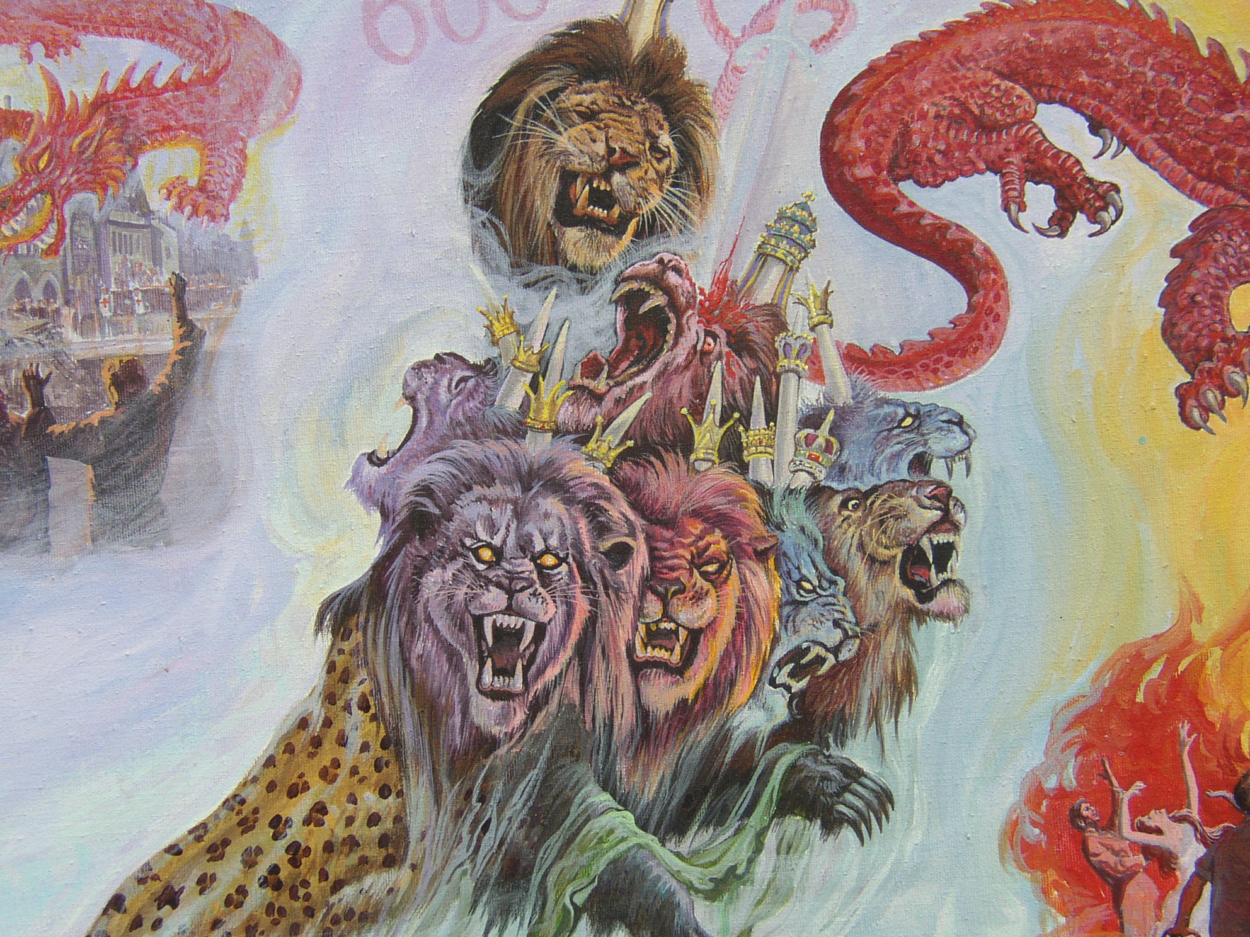
And I saw one of its heads as it were wounded to death…
Rev. 13:3.

Slide 62
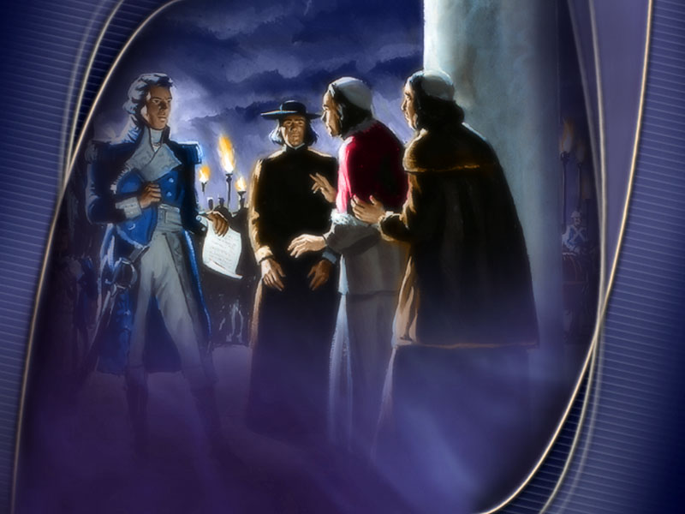
Papacy receives deadly wound
Berthier entered Rome on the 10th of February, 1798,
and proclaimed a republic...
No wonder that half of Europe
thought the papacy was dead.
Joseph Rickaby (Jesuit) The Modern Papacy Lectures on the History of Religion, Lecture 24, (London Catholic Truth Society, 1910), p.1.

Slide 63
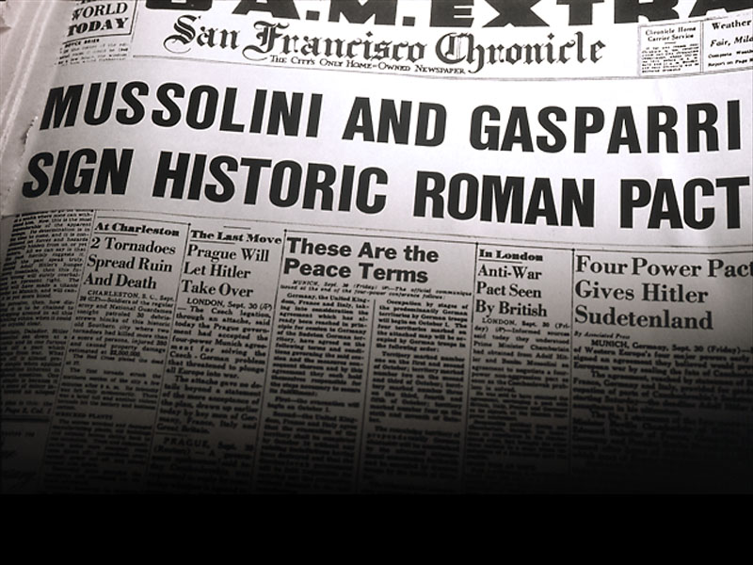
… and his deadly wound was healed… Rev. 13:3.

Slide 64
Agenda concealed - growing influence not discerned
GC 581
God’s word has given warning of the impending danger;
let this be unheeded, and the Protestant world will learn what the purposes of Rome really are, only when it is too late to escape the snare. She is silently growing into power.
Her doctrines are exerting their influence in legislative halls, in the churches, and in the hearts of men.

Slide 65
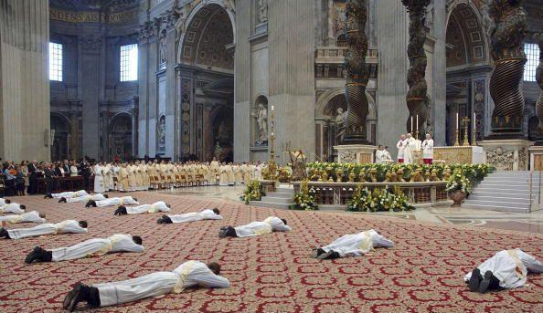
And they worshipped the dragon which gave power unto the beast:
and they worshipped the beast,
saying, Who is like unto the beast? who is able to make war with him?
Rev. 13:4.

Slide 66
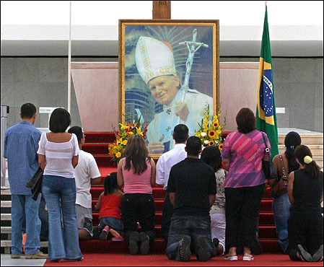
And they worshipped the dragon which gave power unto the beast: and they worshipped the beast… Rev. 13:4.

Slide 67
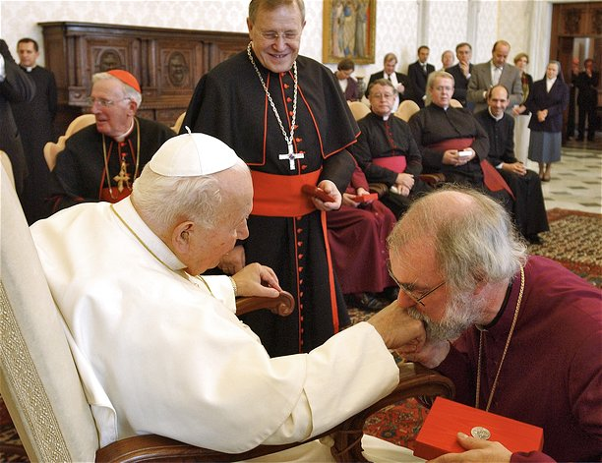
…and they worshipped
the beast…
Rev. 13:4.

Slide 68


Slide 69

And it was given unto him to make war with the saints, and to overcome them: and power was given him over all kindreds, and tongues, and nations.
Rev. 13:7.

Slide 70

And all that dwell upon the earth
shall worship him…
Rev.13:8.

Slide 71

The Second Beast
And I beheld another beast coming up out of the earth; and he had two horns like a lamb… Rev. 13:11.

Slide 72
At what point in history did the narrative about the first beast end?
1798
He that leadeth into captivity
shall go into captivity:
he that killeth with the sword must be killed with the sword... Rev. 13:10.

Slide 73

John Wesley 1754
He is not yet come:
tho’ he cannot be far off.
For he is to appear at
the end of the forty two
months of the first beast.
Explanatory Notes Upon
the New Testament
(1791 ed.), Vol. 3, p.299.
John Wesley 1754

Slide 74

John sees the beast ‘coming up’
(present continuous tense)
a slow ascendency into power

Slide 75
A Christlike Power
…and he had two horns like a lamb…
Rev. 13:11.

Slide 76
What does the Earth Represent?
And I beheld another beast coming up
out of the earth…
Rev. 13:11.

Slide 77

And to the woman were given two wings of a great eagle, that she might fly…

Slide 78

…into the wilderness, into her place, where she is nourished for a time, and times, and half a time,
from the face of the serpent.
Rev. 12:14.

Slide 79

And the earth helped the woman, and the earth opened up her mouth, and swallowed up the flood which the dragon cast
out of his mouth.
Rev. 12:16.
The Earth Represents a place of Refuge

Slide 80

The Earth Represents a place of Refuge

Slide 81

…the land that the Lord provided
as an asylum for His people…
E. G. White, ST June 12, 1893.

Slide 82
The Place [Nation] of Refuge
Give me your tired, your poor, your huddled masses yearning to breathe free,
the wretched refuse of your teeming shore. Send these, the homeless, tempest tossed to me. I lift my lamp beside the golden door.

Slide 83


Protestantism + Republicanism
Government
of the people
by the people
for the people.

Slide 84


What the world had not seen for ages; viz.,
a church without a pope, and a state without a king.
Hon. J. A. Bingham.

Slide 85

The American Constitution
Mr. Franklin, what sort of government do we have?
A Republic,
if you can keep it.

Slide 86

Most of the world followed America’s example
In 1987, on the Constitution’s bicentennial, Time magazine calculated that “of the 170 countries that exist today, more than 160 have written charters modelled directly or indirectly on the U.S. version.” Reported by New York Times, Feb 6, 2012.

Slide 87

Congress of Vienna 1814-1815
The sovereigns of the ‘Holy Alliance’ had massed large armies, and soon entered into a pledge to devote them to
the suppression of all uprisings of the people
in favour of free government…

Slide 88

…and he [Pope Pius VII]
desired to devote the Jesuits, supported by his pontifical power, to the acomplishment of that end.
R. W. Thompson, The Footprints of the Jesuits, 1894, p. 251.

Slide 89

American liberties and principles destroyed by Catholic Church
Revolutionary War hero General Lafayette was born a Romanist.
He said: “If the liberties of the
American people are ever destroyed,
they will fall by the hands
of the Romish clergy.”
Confessions of a French Catholic Priest, America or Rome, Which?
John T. Christian, 1895, p. 61.
General Lafayette

Slide 90

Republic and Democratic principles condemned
by Catholic Church
Our form of government is one based
wholly on the will of the people…
the state is free from all control of the churches… all these principles have been
formally condemned by Rome.
The Independent, New York, June 12, 1913.

Slide 91


Slide 92


Slide 93


Slide 94

American Civil War
1861-1865

Slide 95


Slide 96



Slide 97


Slide 98

Lincoln knew who was behind the war
We owe it to popery that we now see our land reddened with the blood of her noblest sons… I pity the priests when the people realize that they are responsible for
the blood shed in this war.
Charles Chiniquy, Fifty Years In The Church of Rome, (Baker Book House, Grand Rapids,
1968, originally pub. 1886), pp. 296, 297.

Slide 99
Lincoln believed he was fighting the Pope
and the Jesuits
I feel more and more every day that it is
not against the Americans of the South, alone, that I am fighting.
It is more against the Pope of Rome,
his Jesuits and their slaves.

Slide 100
Southern States under influence of the Jesuits
There are only very few of the
Southern leaders who are not more or
less under the influence of the Jesuits, through their wives, family relations
and their friends.

Slide 101
Protestant ministers under influence of the Jesuits
Several members of the family of Jeff Davis are under the influence of the Jesuits.
Even the Protestant ministers are under the influence of the Jesuits, without suspecting it… Rome is doing here what she has done
in Mexico, and all the South American Republics; she is paralyzing, by civil war…
She divides our nation in order to weaken,
subdue and rule it.

Slide 102
Lincoln feared a religious war
It would become merciless
as all religious wars are.
It would become a war of
extermination on both sides.

Slide 103
Lincoln feared a religious war
The Protestants of both the North and
the South would surely unite to exterminate
the priests and the Jesuits if they could
hear what Professor Morse has said to me
of the plots made in the very city of Rome
to destroy this republic…

Slide 104


…I would have laughed at the man who told me that before I became President. But Professor Morse has opened
my eyes on that subject…

Slide 105
Lincoln believed the people were not able to bear the truth
Our people are not ready to learn
and believe those things,
and perhaps it is not the proper time to
initiate them into the dark mysteries of hell… Sooner or later the nation will know…
And those who have caused those desolations
and disasters will be called to give an account.
Charles Chiniquy, Fifty Years In The Church of Rome,
(Baker Book House, Grand Rapids, 1968 , pp. 294-315.

Slide 106

Oath to Papacy stronger than loyalty to nation
During the American Civil War, Pope Pius IX addressed a letter to Jefferson Davis, the Rebel Leader, as ‘illustrious president’.
Hence openly showing his
support for the Southern Rebels. 104,000 loyal Roman Catholics
from the Northern Army
switched sides and
fought for the South.
Avro Manhattan,
The Vatican Moscow Alliance, p. 271.

Slide 107

Jesuit Treachery During Civil War
When General Mead [a Roman Catholic] was fighting for the North in the American Civil War, he defeated R.E. Lee’s army, and was ready to pursue the beaten army till the end of the war. Lincoln had found out that a stranger had come into General Mead’s tent. That stranger was a disguised Jesuit.
Mead took so much time making arrangements that Lee’s army got away. Mead’s loyalty to Rome was greater than his patriotism to his United States.
Charles Chiniquy,
Fifty Years In The Church of Rome, p. 501.
General Mead

Slide 108

European Powers plot to intervene on Confederate side
A convention between Great Britain, France and Spain for joint intervention in Mexico was signed in London
on Oct. 30, 1861. Encyclopedia Britannica,
Art. Mexico, vol. 15, p. 391.
Maximilian of Austria Emperor of Mexico 1864-1867

Slide 109

France invaded Mexico
1861

Slide 110


Slide 111

Lincoln plays his strongest card

Slide 112

Emancipation prevents intervention of European Powers
Lincoln Abolishes Slavery Jan. 1, 1863

Slide 113

Lincoln’s proclamation makes European intervention impossible
The locking up of the world’s source of cotton supply had been a general calamity, and the Confederate government and people had steadily expected that the British and French governments would intervene in the war. The conversion of the struggle into a crusade against slavery made intervention impossible. Encyclopedia Britannica, art. United States of America, vol. 22. p. 767.

Slide 114

Lincoln is threatened by 19th Century ‘high tech’

Slide 115
Lincoln is threatened by 19th Century ‘high tech’
In March 1862, a contract was placed with Laird & Son Co by Captain James D. Bullock, a naval agent for the Confederate States of America, for two double-turreted warships designed for ramming attacks at a cost of £93,750 each, exclusive of armament and ammunition. They were intended, together with other warships, to break the Federal blockade of Confederate coastal cities and to hold some Northern cities for ransom. Gardiner, Robert, ed. (1979). Conway's All the World's Fighting Ships 1860–1905. Greenwich: Conway Maritime Press.

Slide 116

Charles Adams (Lincoln’s ambassador to England) indicted London for
“active malevolence” on the question of the Laird rams, which were ironclad battleships capable of breaking the blockade; as noted, on September 5
he told Foreign Secretary John Russell, “It would be superfluous in me
to point out to your Lordship that this is war.” D. P. Crook, The North, the South,
and the Powers 1861-1865, (New York: John Wiley, 1974). pp. 324, 326.
Lincoln threatens war with Britain if the ships are delivered to the Confederate States
A Laird’s Ram

Slide 117

Lincoln appealed to
Tsar Alexander II of Russia

Slide 118

The Tsar sent the Russian navy to New York and San Francisco

Slide 119

The Russian Ball, New York, Nov. 5, 1863
Bleak are our shores with the blasts of December,
Fettered and chill is the rivulet’s flow;
Thrilling and warm are the hearts that remember
Who was our friend when the world was our foe.
Fires of the North in eternal communion,
Blend your broad flashes with evening’s bright star;
God bless the Empire that loves the Great Union
Strength to her people! Long life to the Czar!
Oliver Wendell Holmes, Complete Poetical Works
(Boston: Houghton Mifflin, 1908), 198-200.

Slide 120


Lincoln and Chiniquy

Slide 121

Lincoln knew the Jesuits were plotting to assassinate him
I am so glad to see you again’ he said,
‘you see that your friends, the Jesuits have not
yet killed me. But they would have surely done it when I passed through their most devoted city, Baltimore, had I not defeated their plans, by passing incognito a few hours
before they expected me…

Slide 122
Lincoln knew the Jesuits were plotting to assassinate him
…so many plots have already been made against my life, that it is a real miracle that they have all failed, when we consider that the great majority of them were in the hands of skillful Roman Catholic murderers, evidently trained by Jesuits.

Slide 123
Lincoln knew the Jesuits were plotting to assassinate him
But can we expect that God will make a perpetual miracle to save my life? I believe not. The Jesuits are so expert in those deeds of blood, that Henry IV said that it was impossible to escape them, and he became their victim, though he did all he could to protect himself. My escape from their hands, since the letter
of the Pope to Jeff Davis has sharpened
a million daggers to pierce my breast,
would be more than a miracle…

Slide 124
Assassination plots
regularly discovered
New projects of assassination are detected almost every day, accompanied with such savage circumstances, that they bring to
my memory the massacre of the St Bartholomew and the Gunpowder Plot.
We feel, at their investigation,
that they come from the same masters
in the art of murder, the Jesuits…
Fifty Years In The Church of Rome,
pp. 493, 501, 506.

Slide 125


Slide 126


The Assassin
John Wilkes Booth

Slide 127

John Surrat escaped first to Canada then to the Vatican
In Papal Zouarv Uniform

Slide 128
Catholic Cover-up
The great, the fatal mistake of the American Government
in the prosecution of the assassins of Abraham Lincoln
was to constantly keep out of sight the religious element
of that terrible drama. Nothing would have been more easy, then, to find out the complicity of the priests,
who were not only coming every week and every day,
but who were even living in that den of murderers.
But this was carefully avoided from the
beginning to the end of the trial.
Fifty Years in the Church of Rome, p. 517.

Slide 129
Rome Ruled in Washington
When not long after the execution of the murderers,
I went, incognito, to Washington to begin my investigation about its true and real authors, I was not a little surprised to see that not a single one of the Government men to whom I addressed myself, would consent to have any talk with me on that matter, except after I had given my word of honor that I would never mention their names in connection with the result of my investigation. I saw with a profound distress, that the influence of Rome was almost supreme in Washington.
I could not find a single statesman who would dare
to face the nefarious influence and fight it down.
Fifty Years in the Church of Rome, p. 517.

Slide 130

America breaks off diplomatic relations with the Vatican 1867

Slide 131

…he had two horns like a lamb, and he spake as a dragon.
Rev. 13:11.

Slide 132

Is America speaking like a Dragon?

